Slide 1

Cortana Intelligence Workshop

Slide 2
Requirements
Windows system with Internet connection without troublesome corporate proxy (e.g. create a Windows virtual machine on Azure)
Azure Subscription (e.g. from MSDN or free trial)
Power BI Subscription (free tier is OK)
Local development tools
Download the Web Platform Installer from https://www.microsoft.com/web/downloads/platform.aspx. Run the Web Platform Installer. Install the following components:
Microsoft Azure PowerShell
Visual Studio Community 2015 with Microsoft Azure SDK – 2.9.6 (or later)
Download and install Data Factory Tools for Visual Studio 2015 at: https://marketplace.visualstudio.com/items?itemName=AzureDataFactory.MicrosoftAzureDataFactoryToolsforVisualStudio2015
Download and install Data Lake Tools for Visual Studio 2015 at: https://www.microsoft.com/en-us/download/details.aspx?id=49504 (select Microsoft.Azure.DataLakeToolsForVS2015.msi)
Optional – if you wish to run most of the steps automatically using PowerShell:
Install PowerShell Extensions for Microsoft SQL Server 2016: from https://www.microsoft.com/en-us/download/details.aspx?id=52676, download and install ENU\x64\PowerShellTools.msi

Slide 3
Requirements
Make sure you use a Windows machine. One step requires the use of a Visual Studio module that only works on Windows.
Do not use the Edge browser as there are compatibility issues with some Azure UIs. Internet Explorer 11, Chrome or Firefox will work.
Do not share an Azure Subscription with other lab participants. We will create some resources that cannot be shared

Slide 4
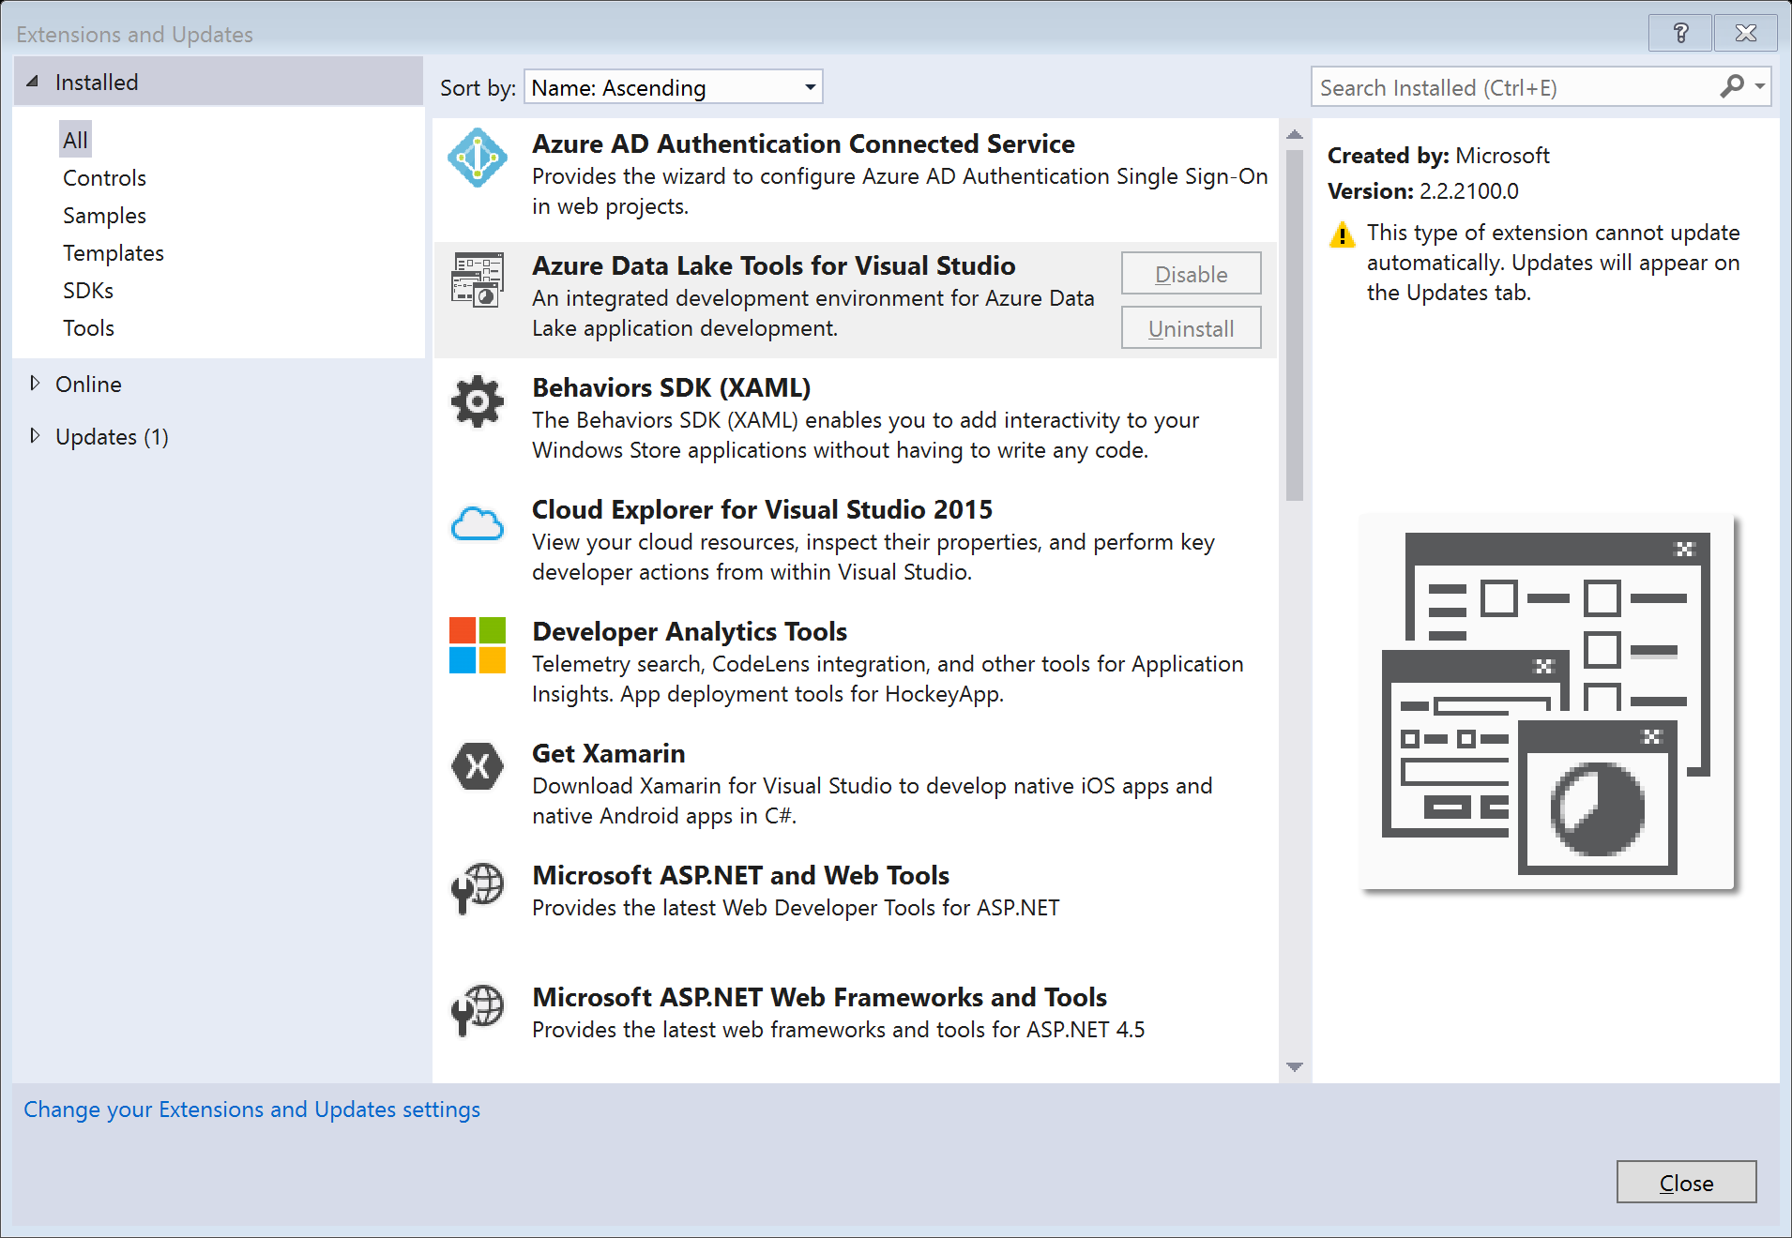
Verify module installation
Open Visual Studio 2015
Go to menu Tools → Extensions and Updates
Under Installed → All:
Check that Azure Data Lake Tools for Visual Studio is present in the list.
Click Azure Data Lake Tools for Visual Studio
Check that the version is at least 2.2.2100.0.

Slide 5
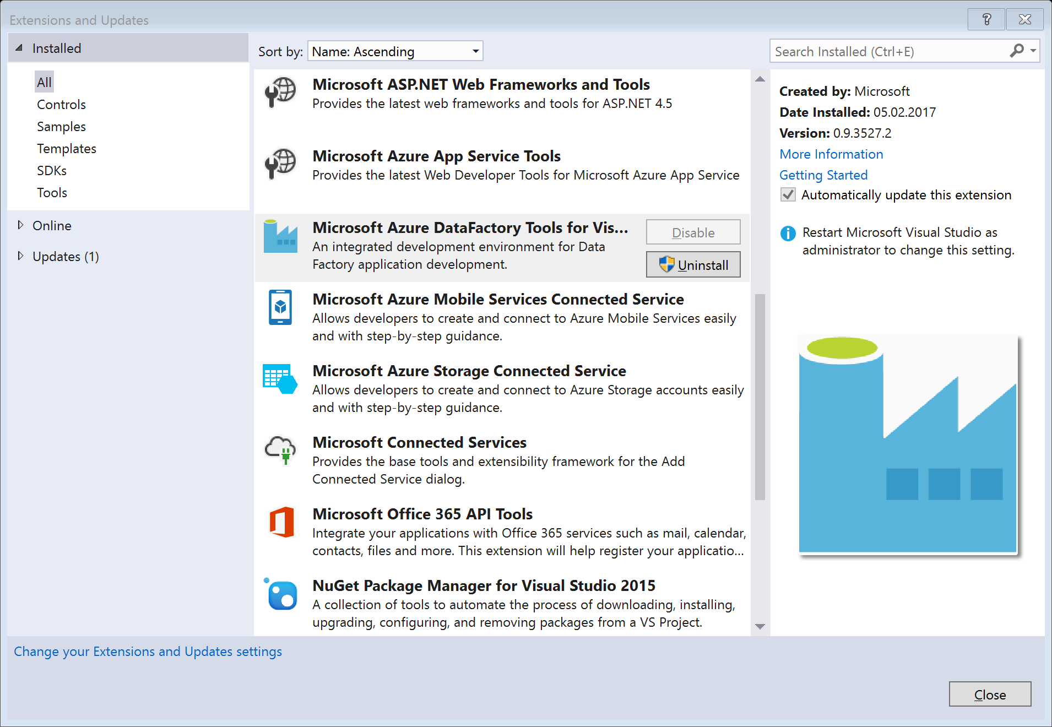
Verify module installation
Under Installed → All:
Check that Azure Data Factory Tools for Visual Studio is present in the list.
Click Azure Data Lake Tools for Visual Studio
Check that the version is at least 0.9.3527.2.

Slide 6
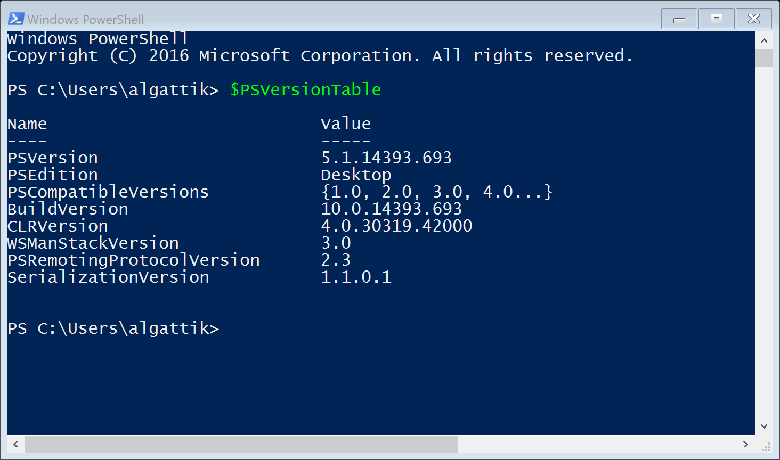
Verify module installation
From the Start menu, open Windows PowerShell
Type $PSVersionTable
Press Enter
Check that PSVersion is at least 5.0

Slide 7
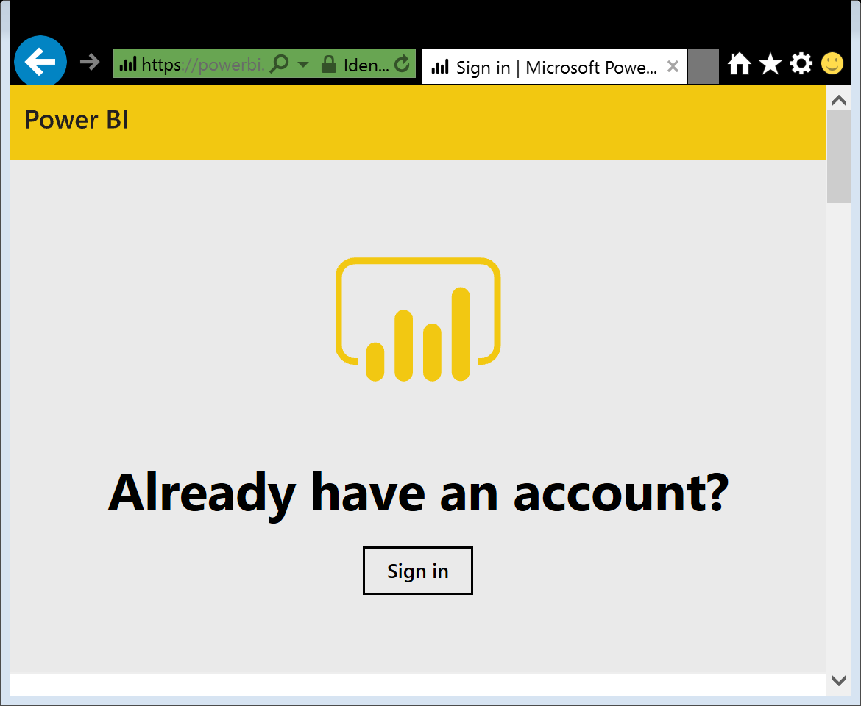
Verify Power BI access
Navigate to https://app.powerbi.com/
Sign in with your corporate credentials
Check that your sign-in is successful
NB: it is fine to use a personal account (for example linked to an Azure Pass) for creating Azure resources for the lab, and a corporate account for Power BI.

Slide 8
Part 1: Customer story

Slide 9
Background
Fabrikam is a manufacturer of compact cars selling in 60 countries. To compete in an increasingly commoditized market, Fabrikam would like build up customer engagement, especially in the young generations which value experiential brands.
Mark, the head of marketing, believes that the company lacks a detailed view of trending topics in social channels, as well as a informal way for customers to approach the company with complaints or inquiries.
Fabrikam car models
Wolverine
Polecat
Sea Otter
Sable

Slide 10
Background
Mark has seen videos about the Microsoft Bot Framework and the Cortana Intelligence Suite.
He’s asked for your support to run an experiment with user engagement bots.
He thinks it is very difficult to predict what kind of interactions the community will have with the bot. He would like to design the system openly, allowing users to formulate complaints or questions. He asks whether artificial intelligence can make the system better and better over time, as it learns from interactions users have with it.
Initially the bot should recognize very broadly what sort of message (e.g. inquiry about a specific model, or about open jobs), and direct the user to a specific page on the web site. Over time the bot should evolve to answer questions based on known information. Finally, if this test is successful, Mark envisions that a customer should be able to select, customize and even order a specific car.

Slide 11
Background
Customers who phone the call center are usually offered (after their request or issue is resolved) to receive a brochure by mail, or to make an appointment for a test drive in a garage. Call centers operators are provided with simple guidelines on what offer should be made for which type of customer.
Mark would like the bot to also make one of these offers to each customer that interacts with it. He thinks this offers significant potential in sales lead generation. However, he wonders whether the current rules really maximize the impact of this channel. For example, customers who call to complain are not normally offered an appointment for a test drive, although they might actually be passionate about the brand.
Mark asks you whether machine learning can help deciding which offer to extend to which customer interacting with the bot.

Slide 12
Background
Mark periodically checks web analytics data. He just saw that a week ago, there was a sudden spike for web searches for «Fabrikam airbags» following an incident where a popular singer was killed by a faulty airbag in a car from another manufacturer. Mark thinks that if he had known this at the time, he would have actively promoted the quality and safety record of the Fabrikam airbags.
Mark expects that the bot channel will allow Fabrikam to capture such trends in real-time. However, he is concerned that it might be complex to find topics in unstructured textual data.
Mark would like to have a dashboard on his mobile phone showing trending topics over the past few days, as well as general sentiment expressed in messages in the bot channel. Sentiment should be in near-real-time and alerts should be generated if a threshold is crossed. This will allow him to react quickly in case of a major event.

Slide 13
Customer questions
I’d like my customers to be able to interact with the bot on our website, but also in Skype and other messaging apps. What does that require in additional development?

Slide 14













Solution Logical Architecture
HOT PATH
LUIS
Cognitive Service
Bot
Logic App
Event Hub
Stream Analytics
Power BI
Select best offer
Sentiment analysis
Key phrase extraction
COLD PATH
Azure ML Web Service
Text Analytics Cognitive Service
Data Lake Analytics
Data Lake Store
SQL Data Warehouse
Operationalize model
Orchestration
Azure ML
Azure Storage
Data Factory

Slide 15
Phased deployment
The solution uses machine learning in multiple places. Cognitive services for sentiment analysis and keyphrase extraction require no training and can be used off-the-shelf. However, the language understanding model (LUIS) and offer acceptance prediction model (Azure ML) require labeled data to be collected before they can be deployed.

Slide 16
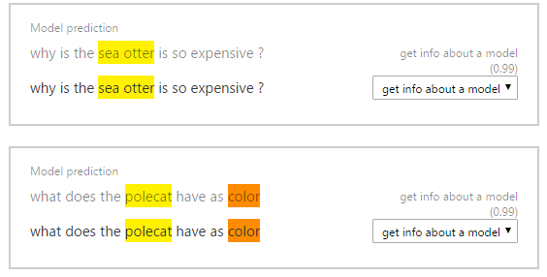
Phased deployment
We will first run the bot with an empty a language understanding model. We will then manually label the utterances collected from the “real world”, so that the understanding model is able to extract and label intents concepts, such as complaining about a particular car model.

Slide 17
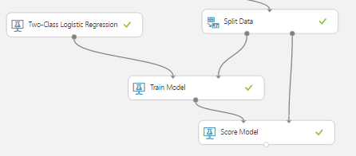
Phased deployment
We will initially build the system without Azure machine learning. The bot will randomly make an offer (brochure or appointment) to each bot user. After a language understanding model is deployed, we will be able to collect structured data to train our model.
We will then create a machine learning model to predict which offer is most likely to be accepted based on the message sent by a bot user. We will then modify the bot to use this machine learning model to make targeted offers.
Finally we will extract trending topics and set-up interactive dashboards to allow deep insights, as well as real-time alerting to allow reacting to surges in negative sentiment.

Slide 18


Phase 1: collect and label utterances
User: What’s the max speed of the Polecat?
Intent: get datasheet information
Bot: <canned answer>
What’s the max speed of the Polecat?
Entity: attribute
Entity: model
Label unknown utterances (http://luis.ai)
Fabrikam analyst

Slide 19
Phases 2 and 3: train and deploy machine learning
Phase 2: Issue a random offer to users, and capture their response
User: What’s the fuel efficiency of the Sable?
Bot: here’s where you can find the datasheet of the Sable
Intent: get datasheet information
Entity: model “Sable”
Entity: attribute “fuel efficiency”
Bot: <random offer>
Build and train a machine learning model
Offer: brochure
Result: accepted
User: <accept or reject the offer>
Phase 3: Instead of a random offer, issue offer most likely to be accepted

Slide 20
Phase 4: cold path processing & analytics
Real-time processing
HOT PATH
Power BI
Key phrase extraction
COLD PATH
Cognitive services (embedded in ADLA)
Data Lake Analytics
Data Lake Store
SQL Data Warehouse
Orchestration
Data Factory

Slide 21
Solution architecture notes
Since Logic apps don’t have a connector to Event hubs yet, an Azure function is used to relay messages in between.
In a real project, a more streamlined solution might be proposed. For example, the Azure extensions for Bot Builder provide a module to write all messages to Azure Tables. However, in this workshop, we introduce Logic Apps and Azure Functions, as they can be used flexibly for rich integration scenarios.
In a real project, we would not always present the user with the offer that’s predicted to be the «best» for that case. In a small, randomly selected fraction of the cases, we would issue a random offer. This allows us to collect data to retrain our models in the future.
For the first version of a bot, it would make sense to start with a Q&A bot, by using the QnA Maker and existing FAQ information.

Slide 22
Part 2: Hackathon

Slide 23
Instructions
The hackathon can be run in two modes:
Manually on the Azure Portal
Follow the instructions in the following pages.
This is recommended if you are relatively new to Azure or Cortana Intelligence Suite.
Using PowerShell to run most of the steps automatically (such as creation and configuration of resources). Some steps are manual, the scripts will guide you with the necessary steps.
Execute the scripts in the Scripts directory line-by-line in PowerShell ISE, in the alphanumeric order. Configurations are in the \CISBotHackathon-master\Config\config.ps1.
This can save time for more experienced users.
Prereqs: Latest Azure PS; comment out 3rd assert in common.ps1 to allow Azure PS version 4.0

Slide 24
Screenshots guide
Internet Explorer 11 (Edge is not compatible with PPT Insert -> Screenshot)
Zoom 150%
No toolbars
Window size: F12 (Developer tools) ->Console -> window.resizeTo(780,640)
Insert screenshots via PPT Insert -> Screenshot

Slide 25
Phase 1: Collect and label utterances

Slide 26
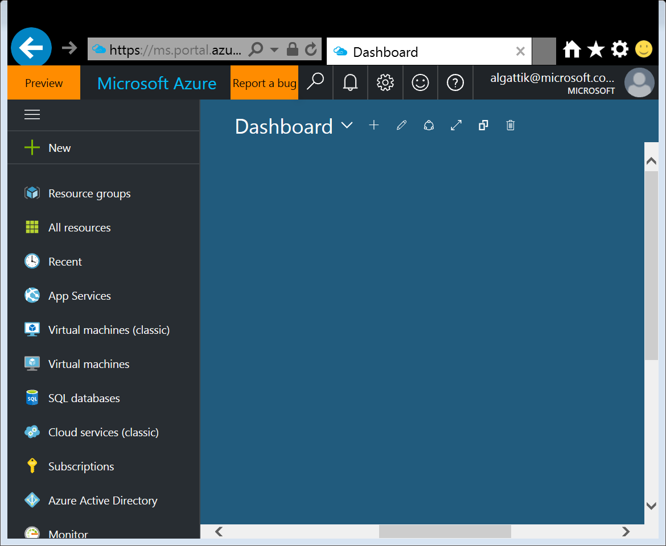
Log into Azure portal
Navigate to https://portal.azure.com
If needed, log in with your Azure credentials

Slide 27
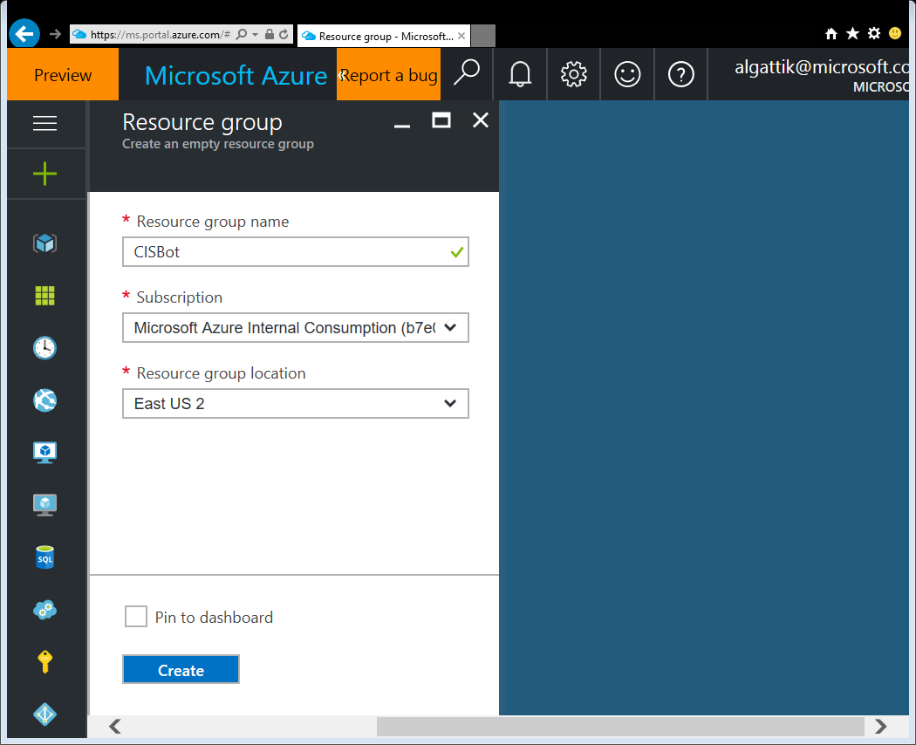
Create a resource group 110-create-resource-group.ps1
We create a resource group as a holder for the various resources we will create in this hackathon. We will create all resources in this resource group.
Go to Resource groups → Add
Enter name (cisbot[nn] where [nn] is your student number).
Select a location where Data Lake is available (https://azure.microsoft.com/en-us/pricing/details/data-lake-store)
At the time of writing, Central US, East US 2, & North Europe are supported.

Slide 28
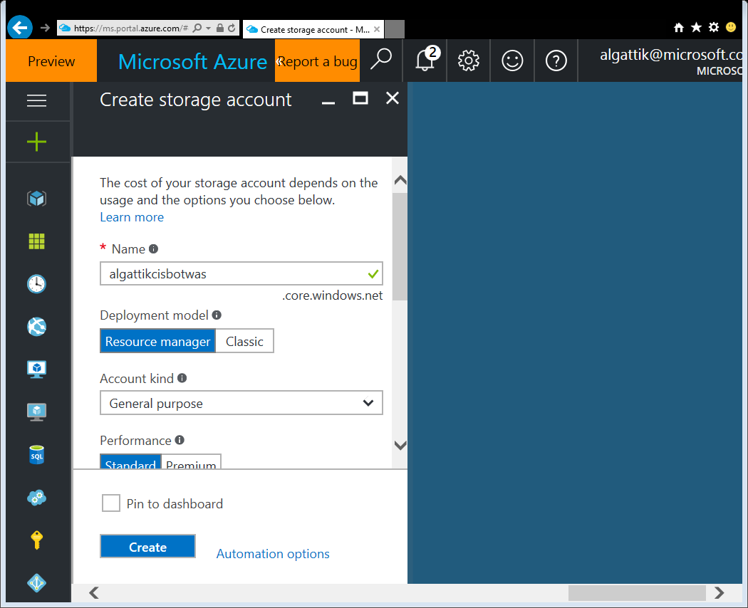
Create a storage account (1/4) 120-create-storage.ps1
We create a storage account to store various datasets and scripts as blobs.
Go to New → Storage → Storage account
Enter a unique name (cisbot[nn]storage)
Leave other parameters to their default value
Select the resource group cisbot[nn]
Click Create

Slide 29
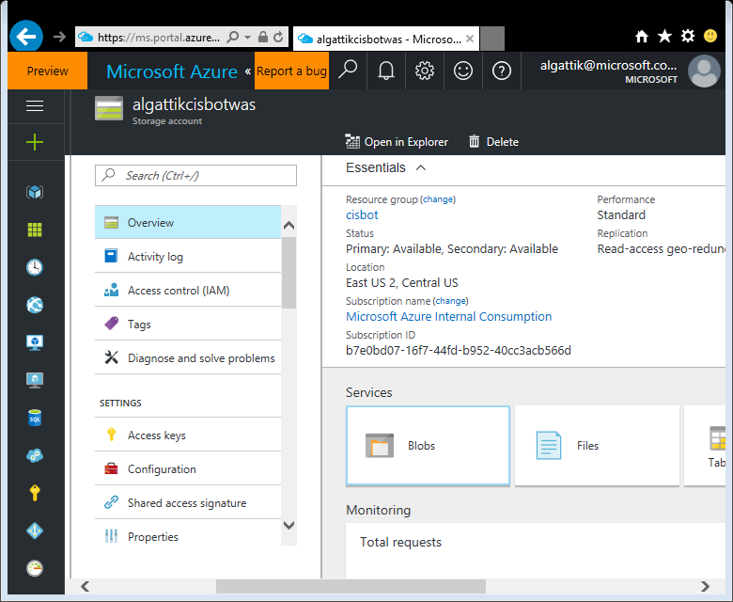
Create a storage account (2/4) 120-create-storage.ps1
Navigate to your newly created Storage account
Click Blobs

Slide 30
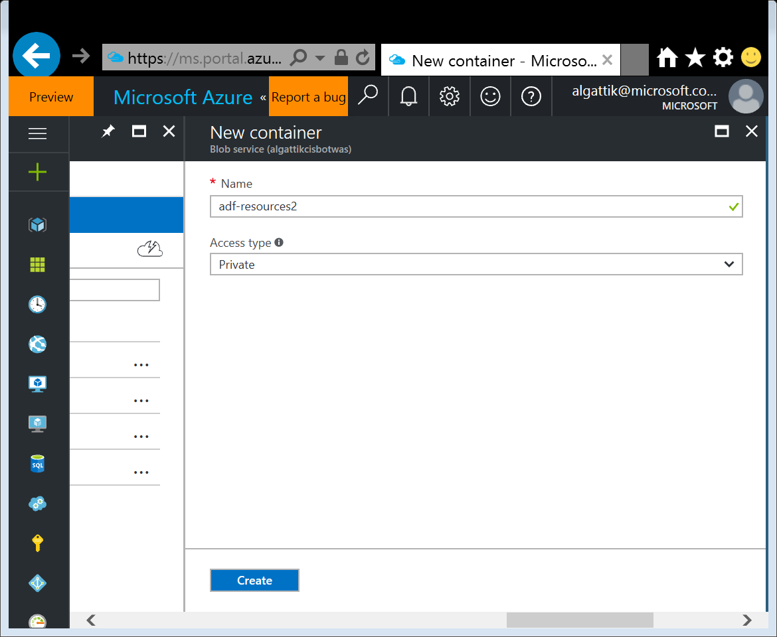
Create a storage account (3/4) 120-create-storage.ps1
Click + Container
Enter name adf-resources
Leave Access type to Private
Click Create

Slide 31
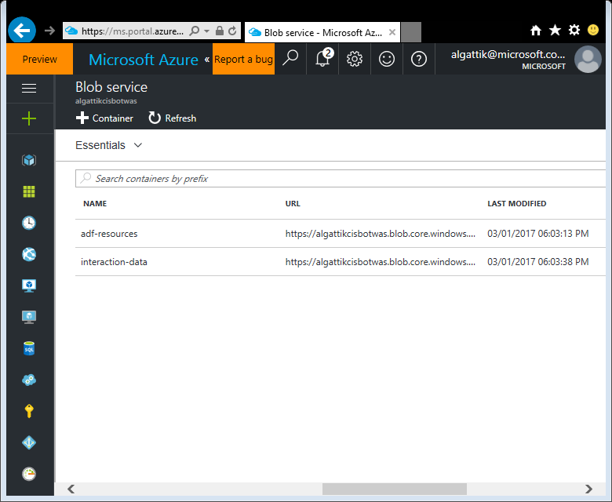
Create a storage account (4/4) 120-create-storage.ps1
Create a second container with name interaction-data

Slide 32
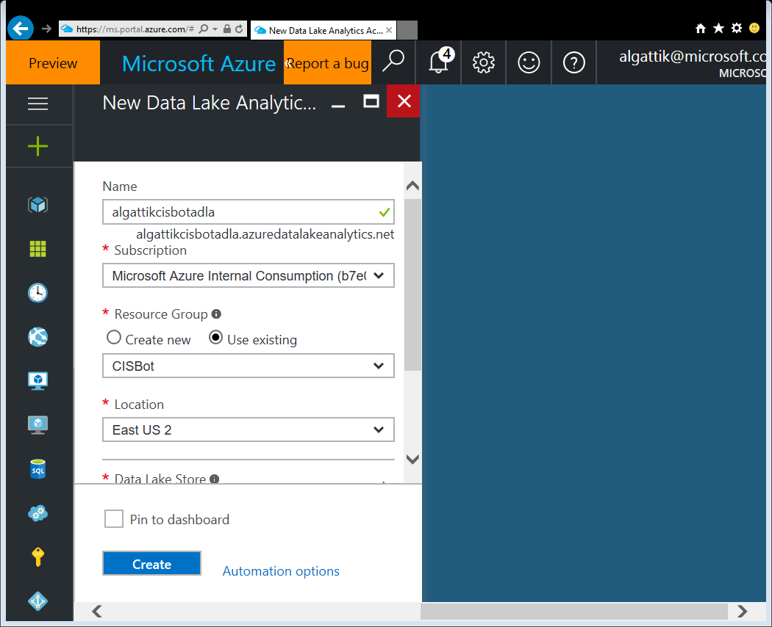
Create a Data Lake (1/2) 130-create-data-lake.ps1
We create a Data Lake Analytics account to run U-SQL jobs. This will also create a Data Lake Store.
Go to New → Intelligence and Analytics → Data Lake Analytics
Enter a unique name (cisbot[nn]adla)
Select the resource group cisbot[nn]

Slide 33
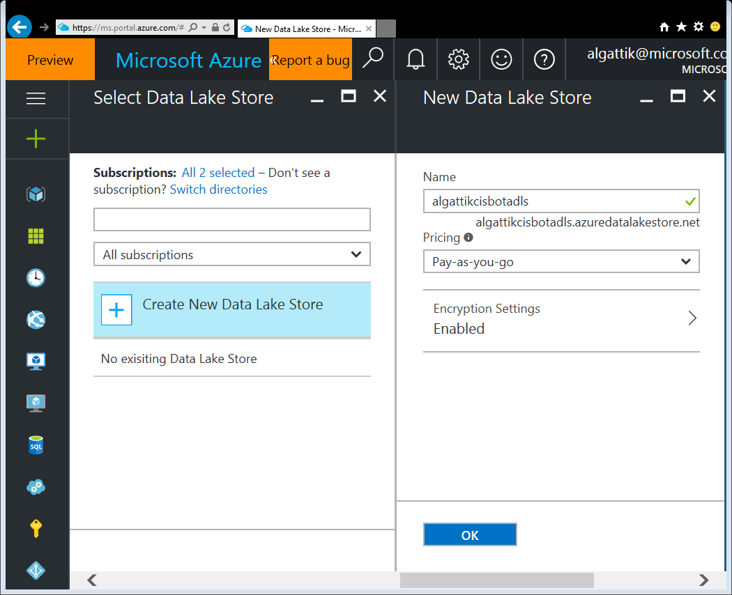
Create a Data Lake (2/2) 130-create-data-lake.ps1
Under Data Lake Store, select Create New Data Lake Store
Enter a unique name (cisbot[nn]adls)
Click OK, then Create

Slide 34
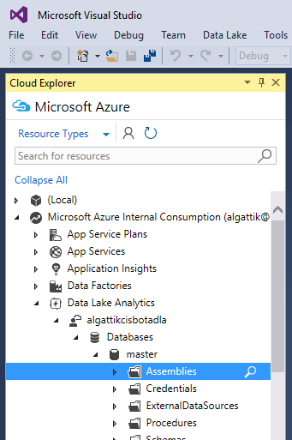
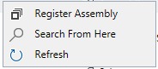
Add JSON library to Data Lake (1/3) 130-create-data-lake.ps1
Data Lake Analytics comes with an XML parser, but parsing JSON requires a custom extension. We add it to our account.
Open the Cloud Explorer view in Visual Studio. Enter your credentials for your Azure account if needed
Under your Data Lake Analytics account → Databases → master, Right-click Assemblies, then click Register Assembly
⚠ Do not select the (Local) account!

Slide 35
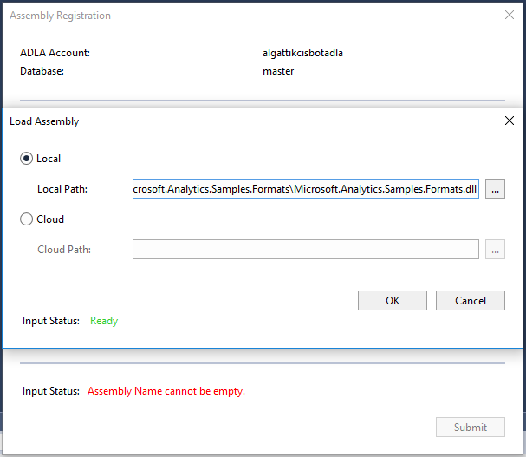
Add JSON library to Data Lake (2/3) 130-create-data-lake.ps1
Under Load assembly from Path, Local, select the path to Resources\ADLA-JSON-Assembly\Microsoft.Analytics.Samples.Formats\Microsoft.Analytics.Samples.Formats.dll
Click OK

Slide 36
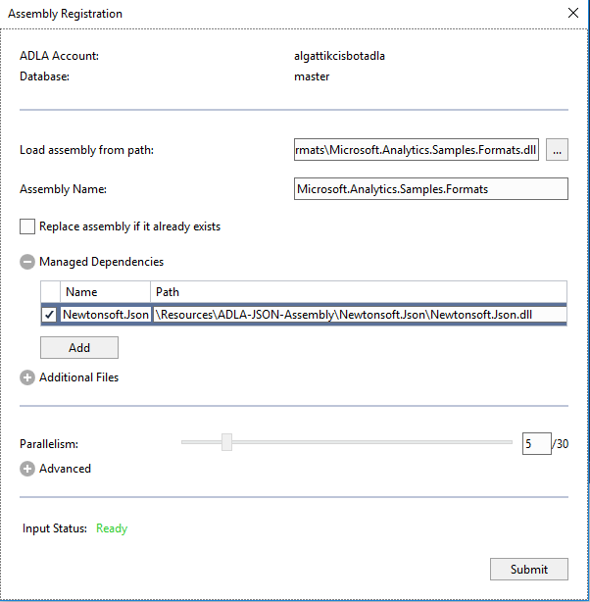
Add JSON library to Data Lake (3/3) 130-create-data-lake.ps1
Under Managed Dependencies, click the checkbox next to Newtonsoft.Json
Under Path,Select “…”, Local, select the path to Resources\ADLA-JSON-Assembly\Newtonsoft.Json\Newtonsoft.Json.dll
Click Submit. If prompted to select a Path, click Yes to accept the default proposal.

Slide 37
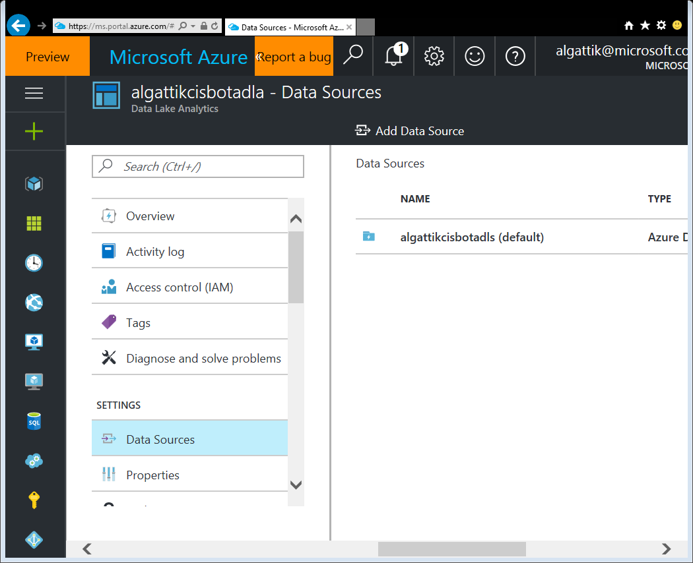
Connect Blob storage to Data Lake Analytics (1/2) 130-create-data-lake.ps1
Azure ML can’t connect directly to Data Lake Store (yet), so we will have our Data Lake job write out data for Azure ML to Blob storage. This requires connecting our Data Lake Analytics account to our storage account.
Under your Data Lake Analytics account, select SETTINGS → Data Sources, then Add Data Source

Slide 38
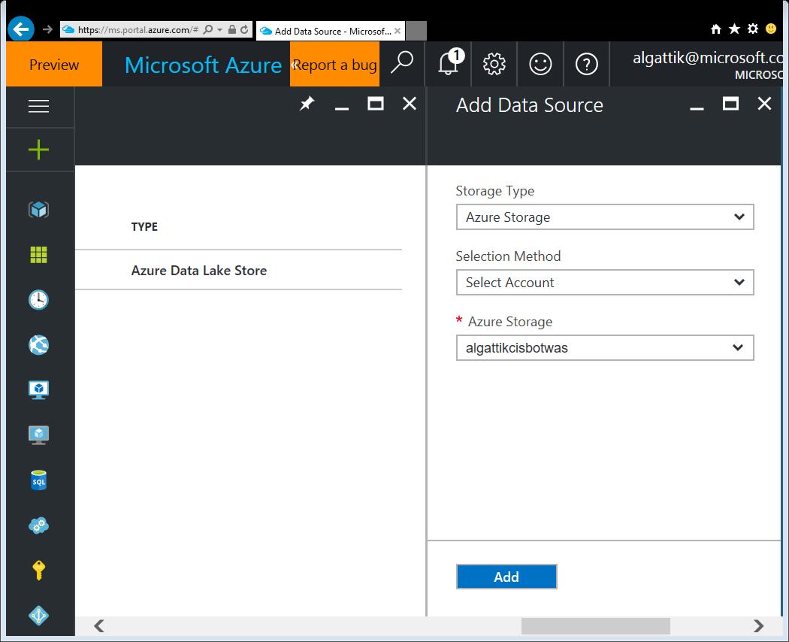
Connect Blob storage to Data Lake Analytics (2/2) 130-create-data-lake.ps1
Select:
Storage Type: Azure Storage
Azure Storage: the storage account you have previously created
Click Add

Slide 39
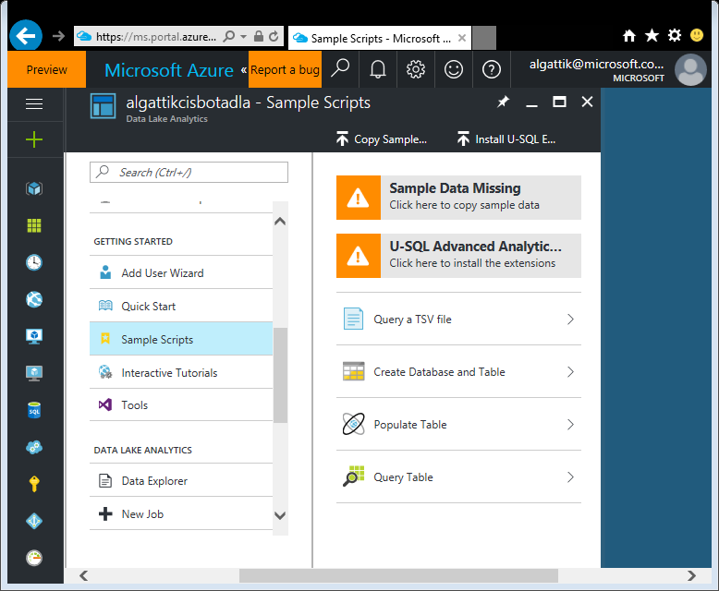
Add advanced extensions to Data Lake
Install cognitive extensions for text analytics
In your newly created Data Lake Analytics account, browse to GETTING STARTED → Sample Scripts
Click the “USQL Advanced Analytic…” to install the advanced extensions for text analytics
In a future release, advanced extensions will be installed automatically at data lake creation time.

Slide 40
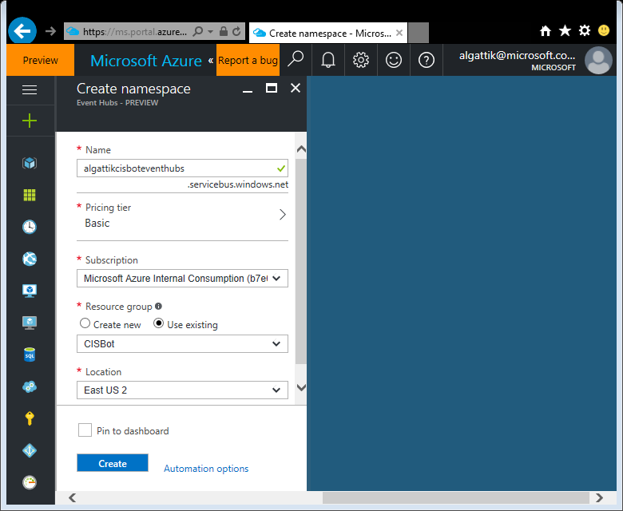
Create Event Hub (1/5) 140-create-event-hub.ps1
Create an Event Hub – the component for ingestion and transient storage of events for consumption by Stream Analytics.
Go to New → Internet of Things→ Event Hubs
Enter a unique name (cisbot[nn]eventhubs)
Select Pricing tier Basic
Select the resource group cisbot[nn]
Click Create

Slide 41
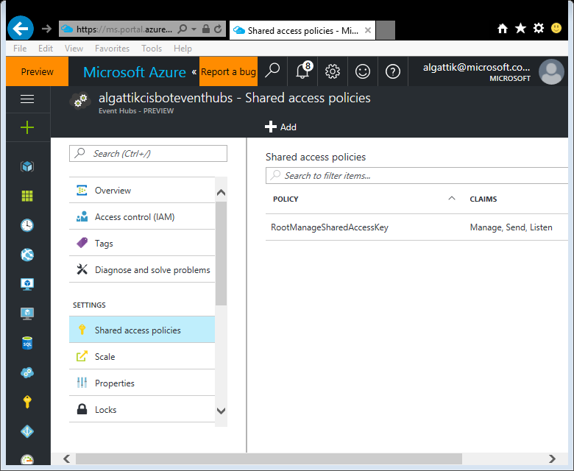
Create Event Hub (2/5) 140-create-event-hub.ps1
Navigate to your newly created Event Hubs namespace
Click SETTINGS → Shared access policies
Click + Add

Slide 42
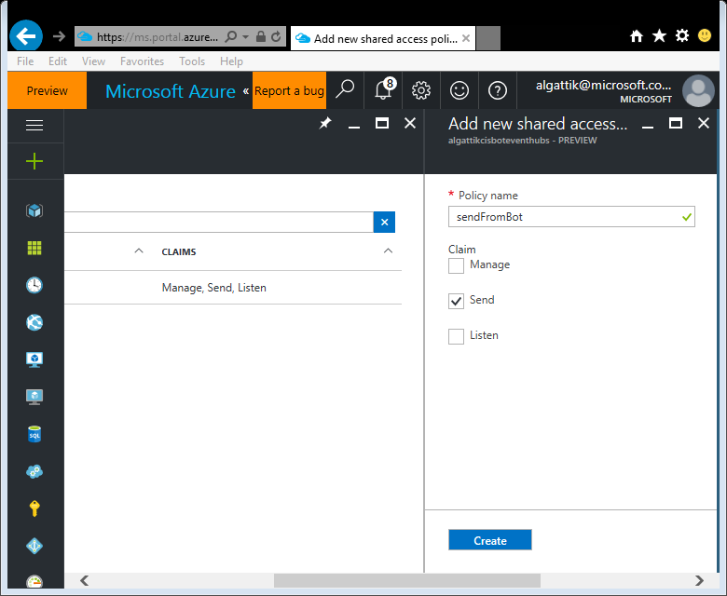
Create Event Hub (3/5) 140-create-event-hub.ps1
Enter name sendFromBot
Allow claim Send
Click create

Slide 43

Create Event Hub (4/5) 140-create-event-hub.ps1
Now add another policy with name listenIntoStreamAnalytics
Allow claim Listen
Click create

Slide 44
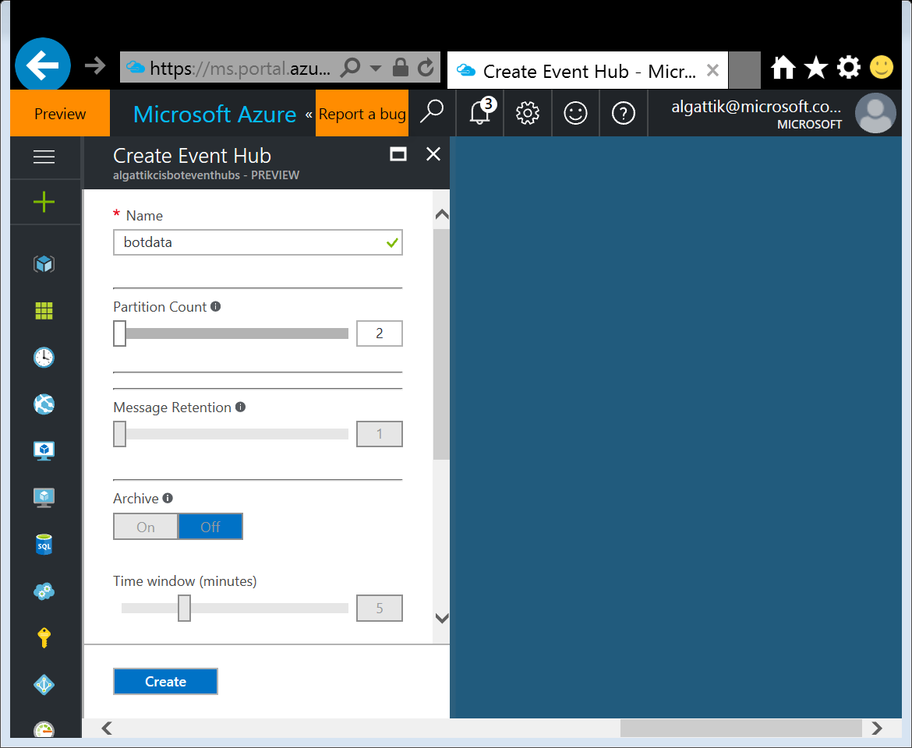
Create Event Hub (5/5) 140-create-event-hub.ps1
Navigate to ENTITIES → Event Hubs
Click + Event Hub
Enter name botdata
Click Create

Slide 45
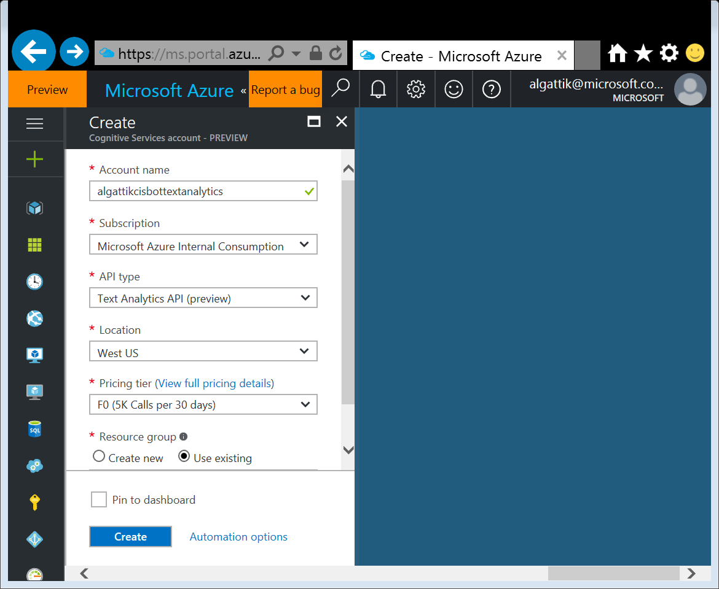
Create Logic App (1/10) 160-create-logic-app.ps1
Create Text Analytics Cognitive Service to be used for sentiment analysis.
Go to New → Intelligence & Analytics → Cognitive Services API
Enter a name (cisbot[nn]textanalytics)
Select API type: Text Analytics API
Select free Pricing tier (S1)
Select any Location
Select your resource group
Click Create

Slide 46
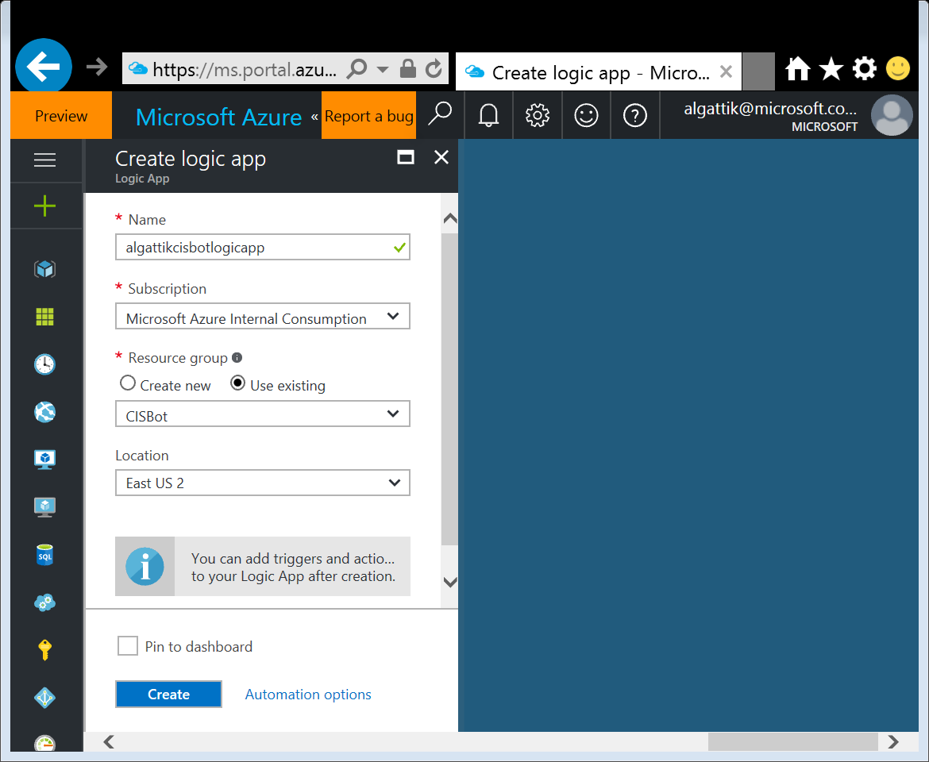
Create Logic App (2/10) 160-create-logic-app.ps1
Create a Logic App, i.e. an integration workflow that will be run text analytics on bot messages and forward them.
Go to New → Enterprise Integration → Logic App
Enter a name (cisbot[nn]logicapp)
Select your Resource group
Click Create

Slide 47
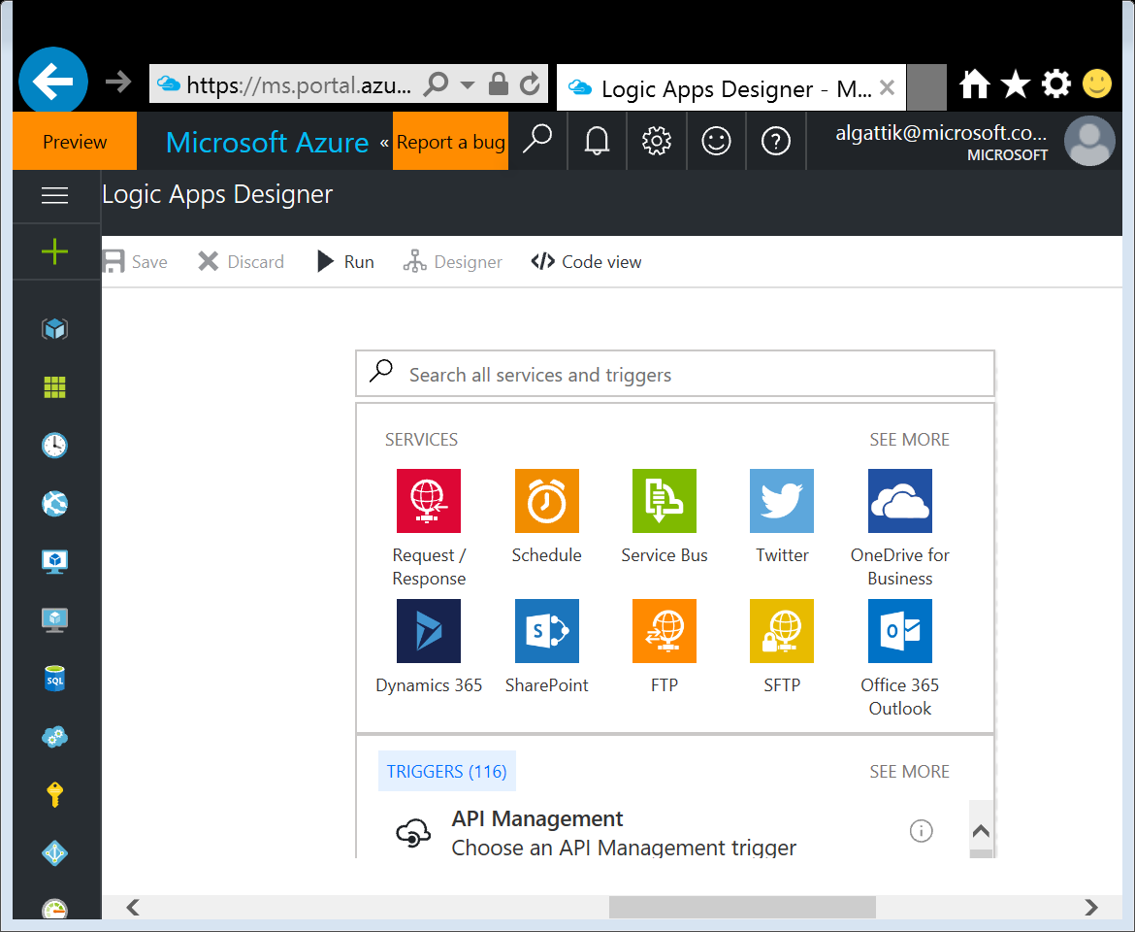
Create Logic App (3/10) 160-create-logic-app.ps1
Select Logic App trigger
Navigate to your recently created Logic App
Click Edit
Select Blank LogicApp
For trigger, Click Request / Response (twice)

Slide 48
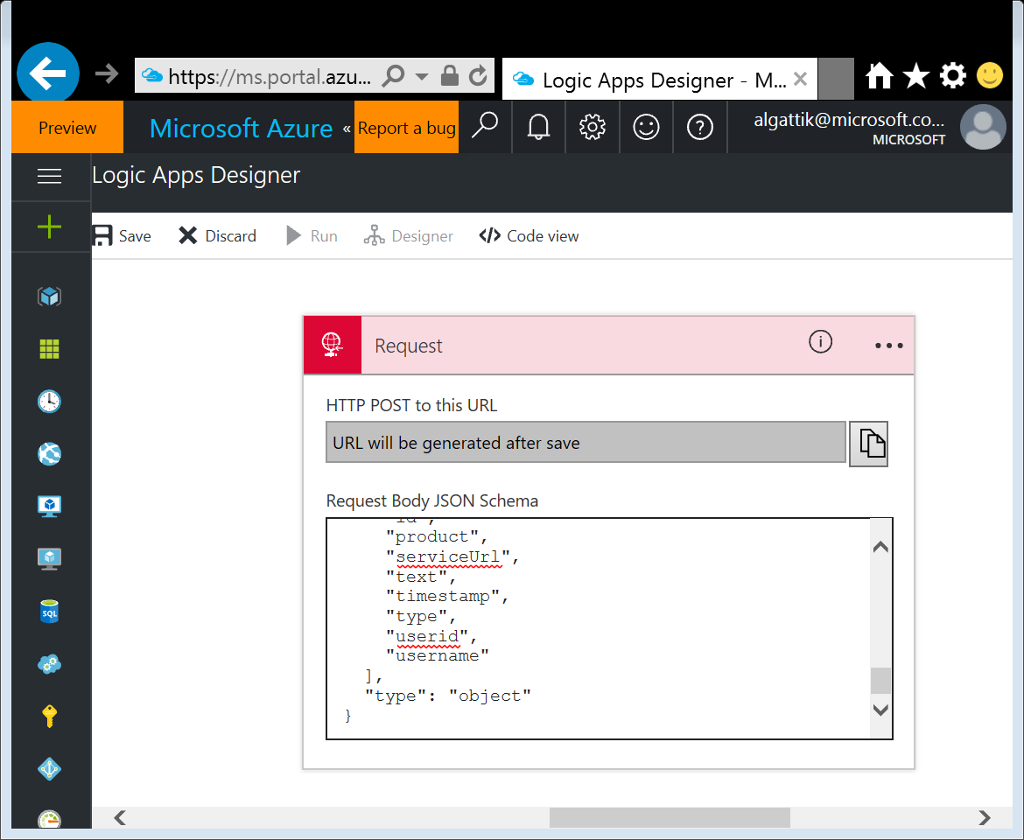
Create Logic App (4/10) 160-create-logic-app.ps1
Specify request JSON schema
Copy the content Resources\TextAnalyticsLogicApp\request-schema.json into the Request Body JSON Schema field

Slide 49
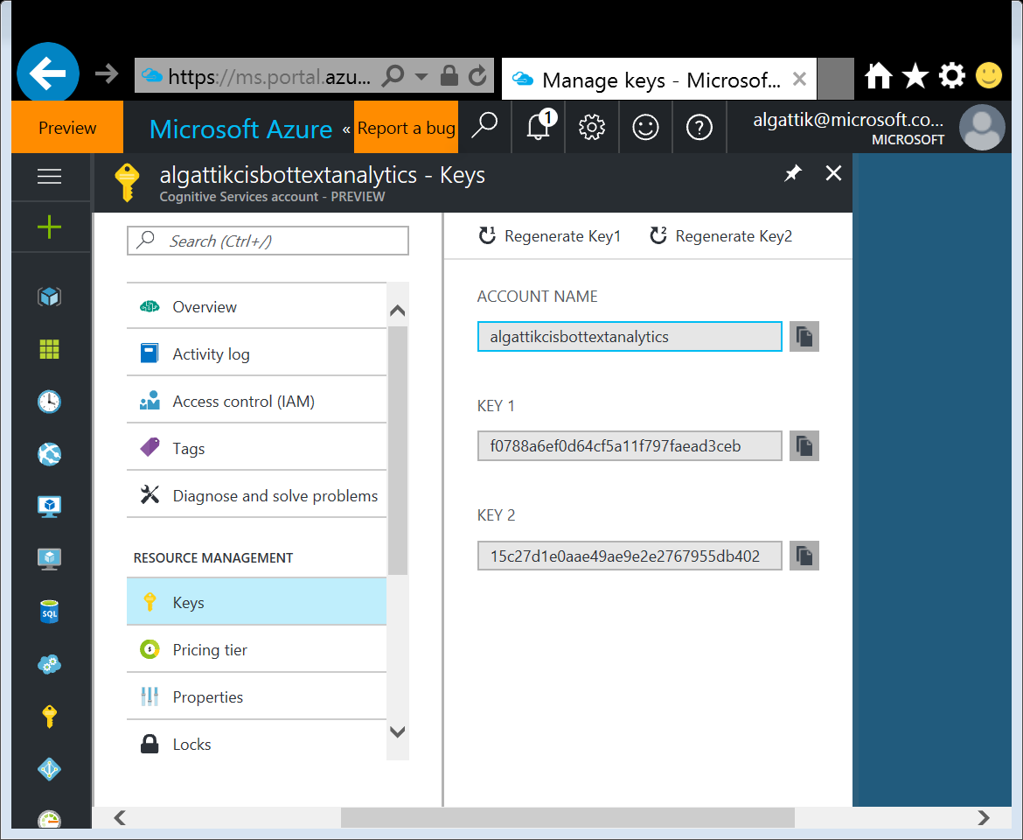
Create Logic App (5/10)
Copy Text Analytics service key
Navigate to your recently created Cognitive Services account
Click RESOURCE MANAGEMENT → Keys
Copy Key 1

Slide 50
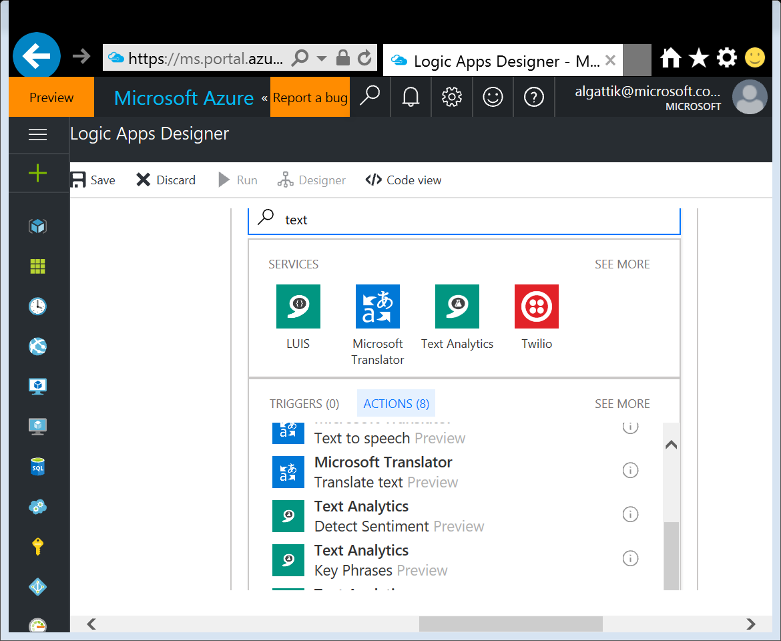
Create Logic App (6/10)
Create new Logic App Action to do sentiment detection
Navigate to your recently created Logic App
Click Edit
Click New step → Add an action
In the search box, type text
From the result list, select Text Analytics – Detect Sentiment

Slide 51
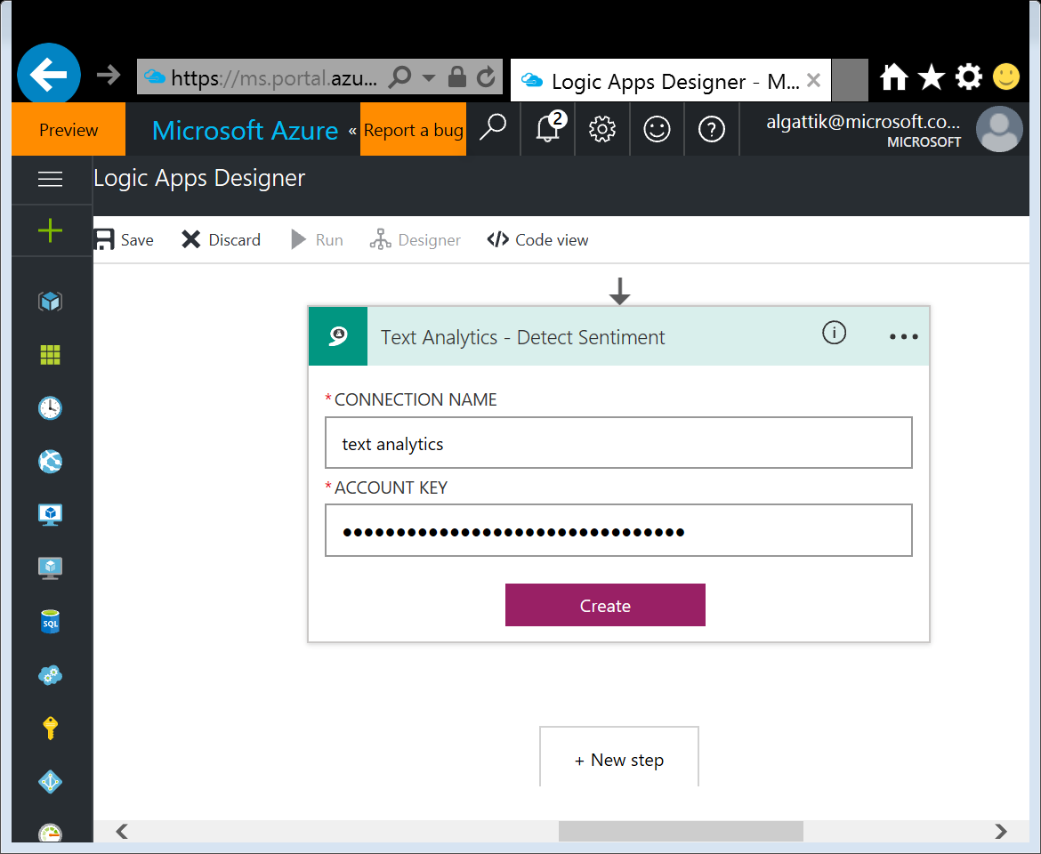
Create Logic App (7/10)
Create Text Analytics API Connection
Enter any name (sentiment analysis)
Enter the key of the Cognitive Service, that you copied in a previous step
Click Create

Slide 52
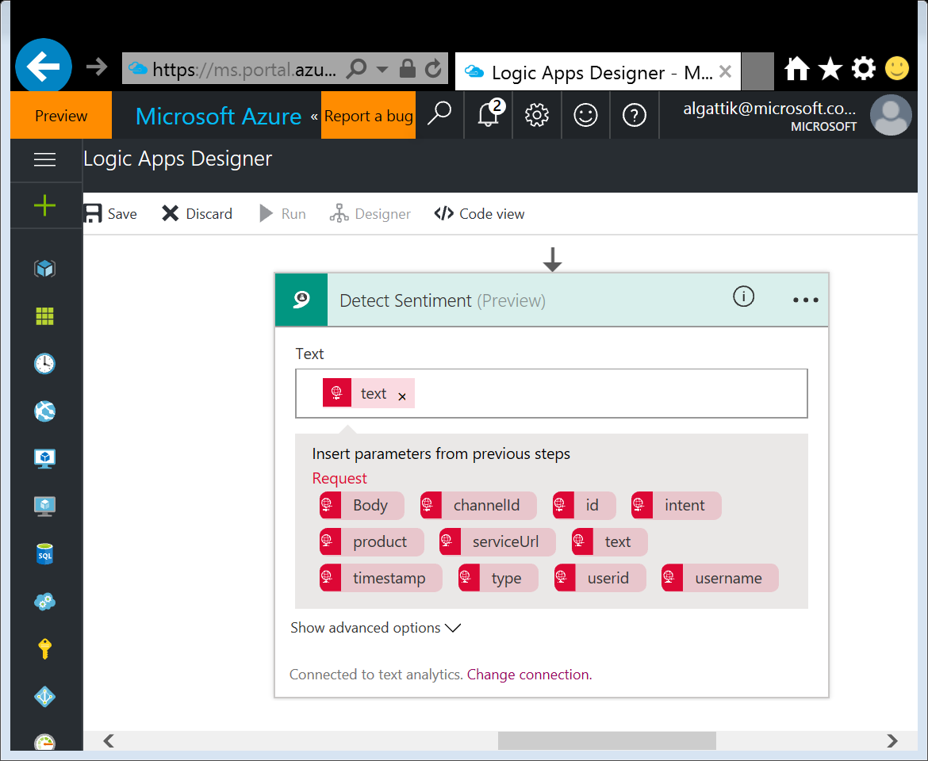
Create Logic App (8/10)
As input for the Detect Sentiment action, select the text field

Slide 53
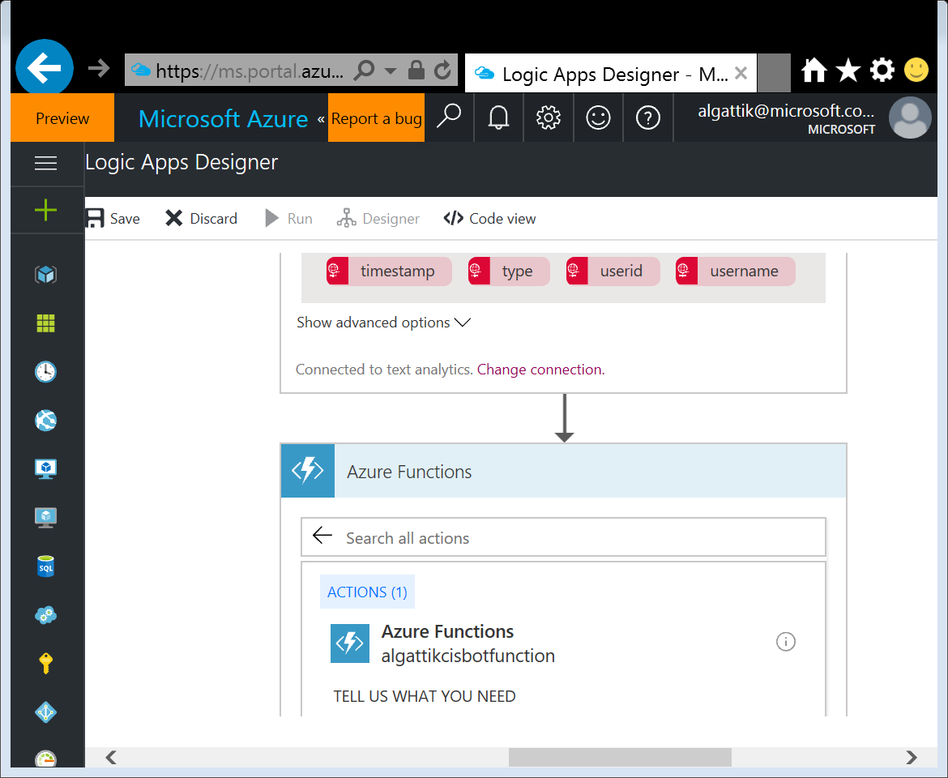
Create Logic App (9/10)
Create new Logic App Action and API Connection to Event Hub
Click New step → Add an action
In the search box, type event hubs
From the result list, select Event Hubs – Send event
Enter any name (send to Event Hub)
Under Event Hubs Namespace, choose the event hub created earlier.
Select RootManageSharedAccessKey access policy
Click Create

Slide 54
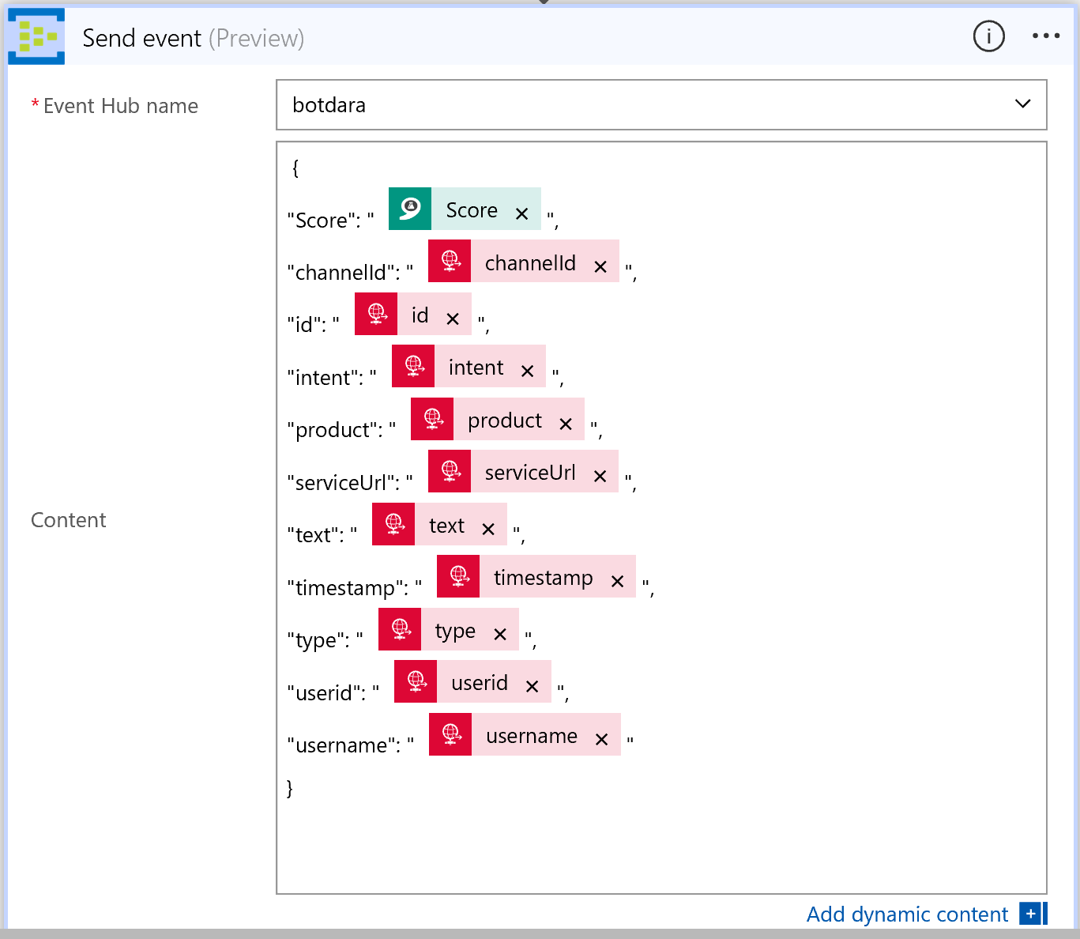
Create Logic App (10/10)
Select Event Hub name (botdata)
Copy the following JSON to the Content field. Fill the values with dynamic content placeholders.
Click Save
{
"Score": "",
"channelId": "",
"id": "",
"intent": "",
"product": "",
"serviceUrl": "",
"text": "",
"timestamp": "",
"type": "",
"userid": "",
"username": ""
}

Slide 55
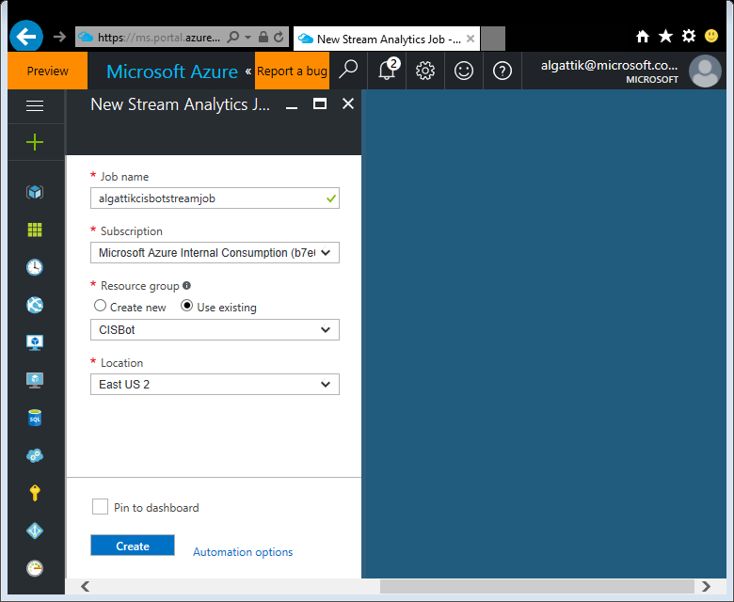
Create Stream Analytics (1/6) 170-create-stream-analytics.ps1
We create a Stream Analytics job, that pulls bot messages from the Event Hub and store them in the Data Lake Store. In addition, it computes average sentiment over a time window and forwards that data to Power BI for real-time dashboarding.
Go to New → Internet of Things → Stream Analytics Job
Enter a name (cisbot[nn]streamjob)
Select your resource group
Click Create

Slide 56
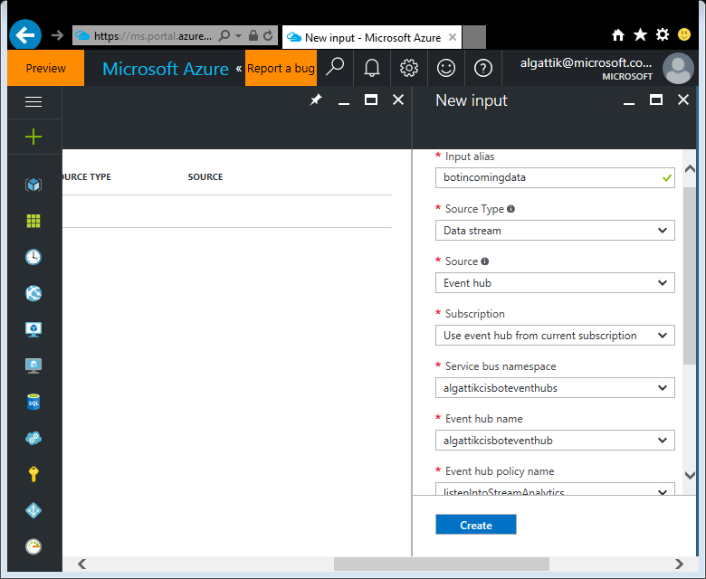
Create Stream Analytics (2/6) 170-create-stream-analytics.ps1
Navigate to your newly created Stream Analytics Job
Click JOB TOPOLOGY → Inputs, then + Add
As Input alias, enter botincomingdata
Select your event hub namespace, name, and listen policy
Click Create

Slide 57
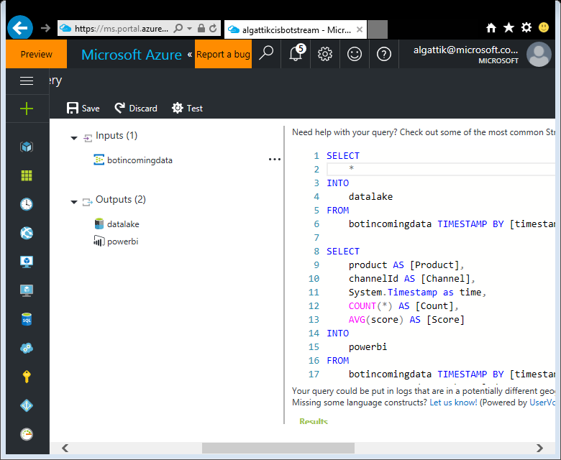
Create Stream Analytics (3/6) 170-create-stream-analytics.ps1
Click JOB TOPOLOGY → Query, then + Add
Paste the following query
Click Save
SELECT
*
INTO
datalake
FROM
botincomingdata TIMESTAMP BY [timestamp]
SELECT
product AS [Product],
channelId AS [Channel],
System.Timestamp as time,
COUNT(*) AS [Count],
AVG(score) AS [Score]
INTO
powerbi
FROM
botincomingdata TIMESTAMP BY [timestamp]
GROUP BY product, channelId,
TumblingWindow(minute, 1)

Slide 58
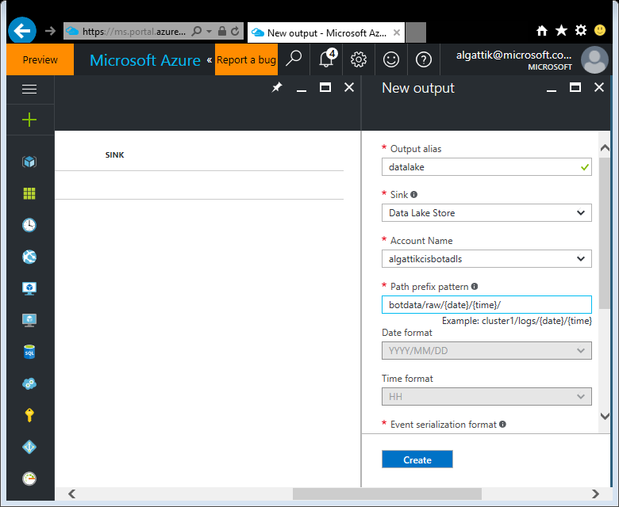
Create Stream Analytics (4/6)
Click JOB TOPOLOGY → Outputs, then + Add
As Output alias, enter datalake
As Sink, select Data Lake Store
Click Authorize
Select subscription and Data Lake Store account
As Path prefix pattern, enter botdata/raw/{date}/{time}/
Click Create

Slide 59
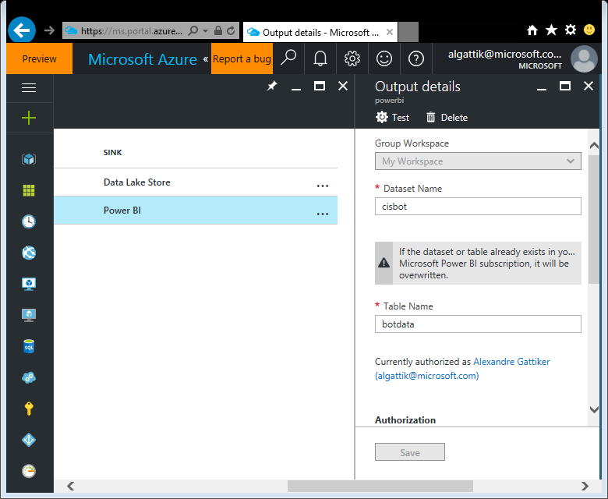
Create Stream Analytics (5/6)
Under Outputs, click Add
As Output alias, enter powerbi
As Sink, select Power BI
Click Authorize
As Dataset Name, enter cisbot
As Table Name, enter botdata
Click Create

Slide 60
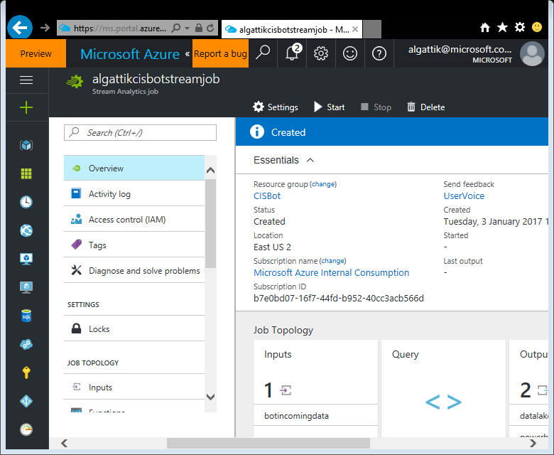
Create Stream Analytics (6/6)
Under Overview, click Start
As job start time, select Now
Click Start

Slide 61
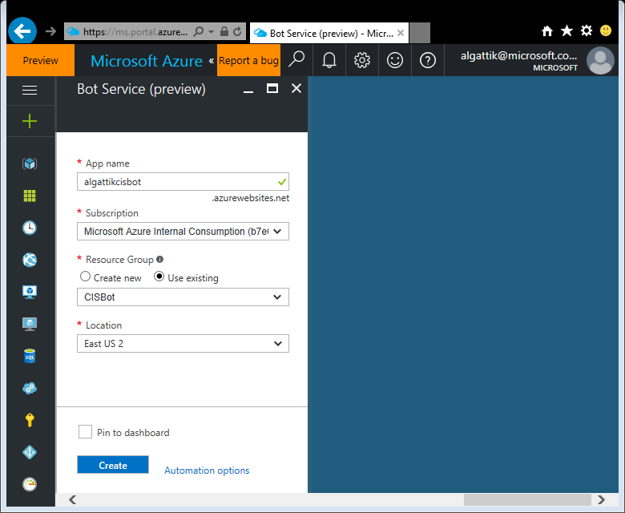
Create your Bot (1/7) 210-create-bot.ps1
Create LUIS Cognitive Service used by Bot Service
Go to New → Intelligence & Analytics → Cognitive Services API
Enter a name (cisbot[nn]luis)
Select API type: Language Understanding Intelligent Service
Select Pricing tier (S0)
Select any Location
Select your resource group
Click Create

Slide 62
Create your Bot (2/7)
We create the bot, as a web application based on the open-source bot framework for interactive conversations.
Go to New → Intelligence + Analytics → Bot service
Click Create
Enter a unique name (cisbot[nn]botservice)
Select your resource group
Select your location
Click Create

Slide 63
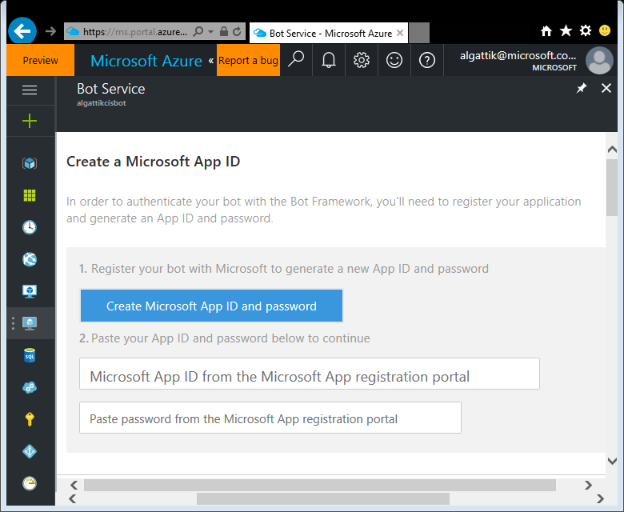
Create your Bot (3/7)
Navigate to your newly created Bot Service
Click Create Microsoft App ID and password
You will need to use a Microsoft account (not a corporate account). If you don’t have one, you can create a personal one at that step.
Click Generate an app password to continue

Slide 64
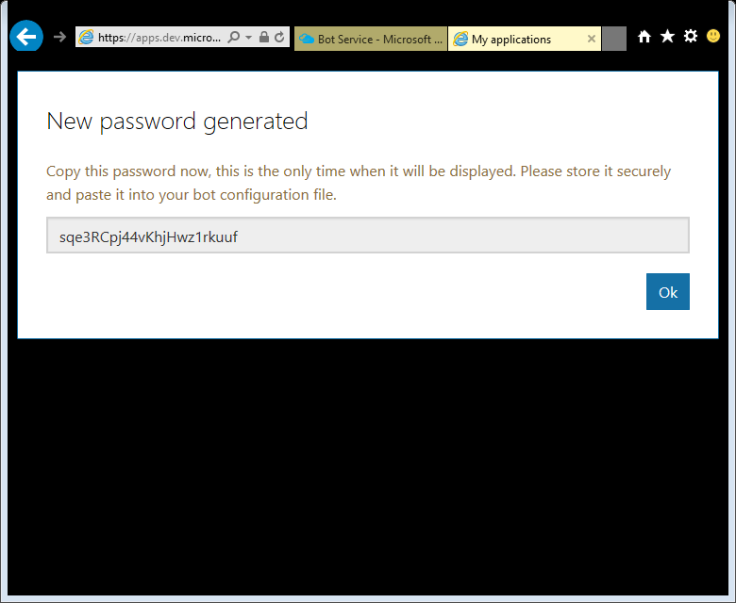
Create your Bot (4/7)
When the password is displayed, select copy it to the clipboard (Ctrl-C)
Click Finish and go back to Bot Framework

Slide 65
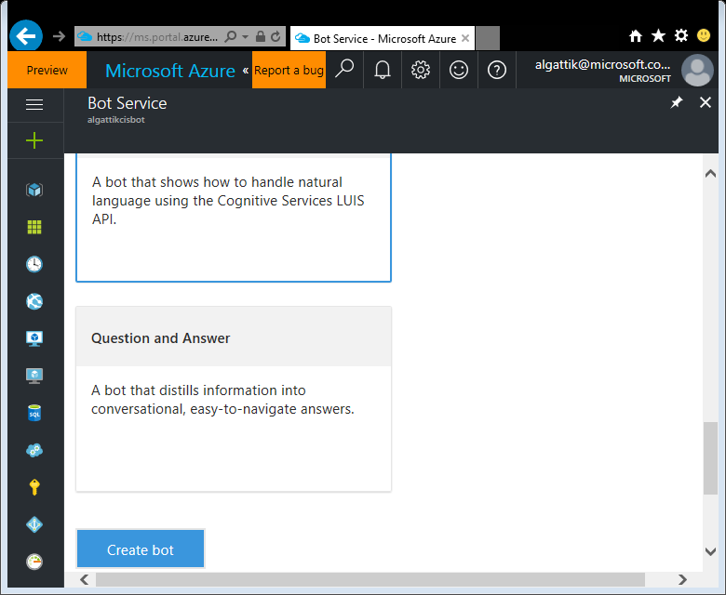
Create your Bot (5/7)
Paste your password
In Choose a Language, select C#
In Choose a Template, select Language understanding
Agree to the Terms of Use
Click Create Bot
When the window “Connect Azure Bot Service to LUIS” appears, Sign in if asked, then click Continue
Generating the bot will take a few minutes.

Slide 66
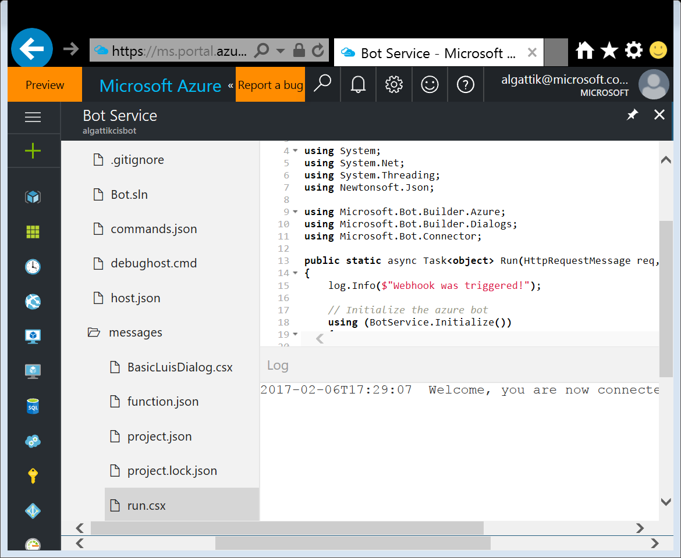
Create your Bot (6/7)
Open the file BasicLuisDialog.csx

Slide 67
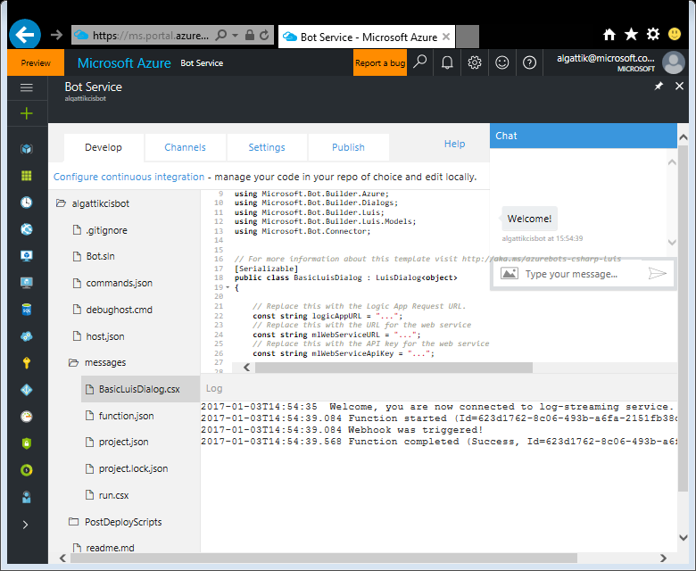
Create your Bot (7/7)
Replace the content with the content of the file Resources/Bot/BasicLuisDialog.csx
⚠ Make sure you paste the code into the file BasicLuisDialog.csx !
We need the Logic App Request URL. You will find it in the next step or as printed in the PowerShell script.
⚠ Do not paste the code into run.csx!

Slide 68
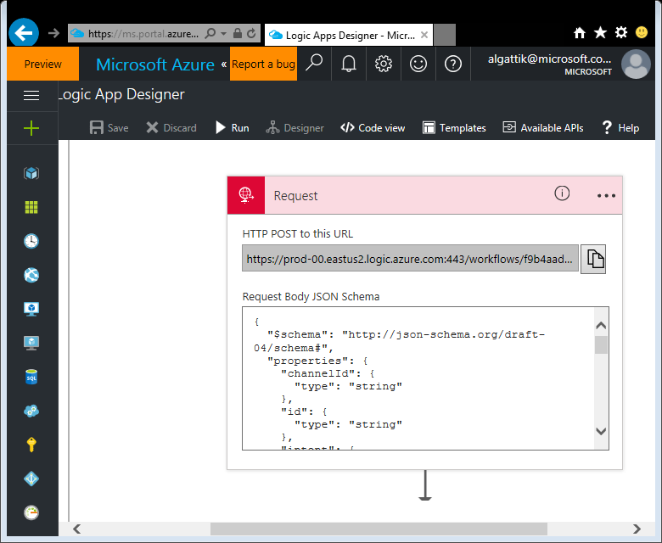
Integrate your Bot with your Logic App (1/2)
Navigate to your Logic App
Click Edit
Copy the HTTP POST URL to the clipboard

Slide 69
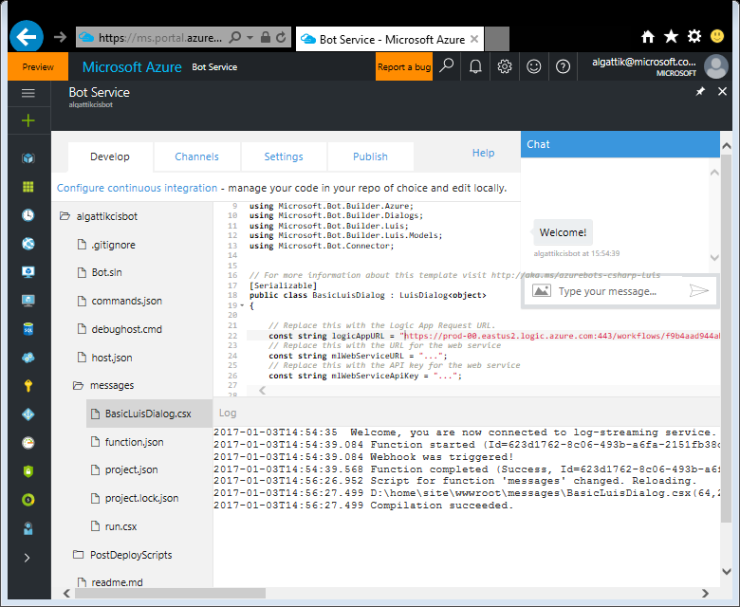
Integrate your Bot with your Logic App (2/2)
Paste the value of the Logic App Request URL into the logicAppURL constant definition, in BasicLuisDialog.csx.
Leave the mlWebService* constants as-is for now, we will fill them in later.
Click Save

Slide 70
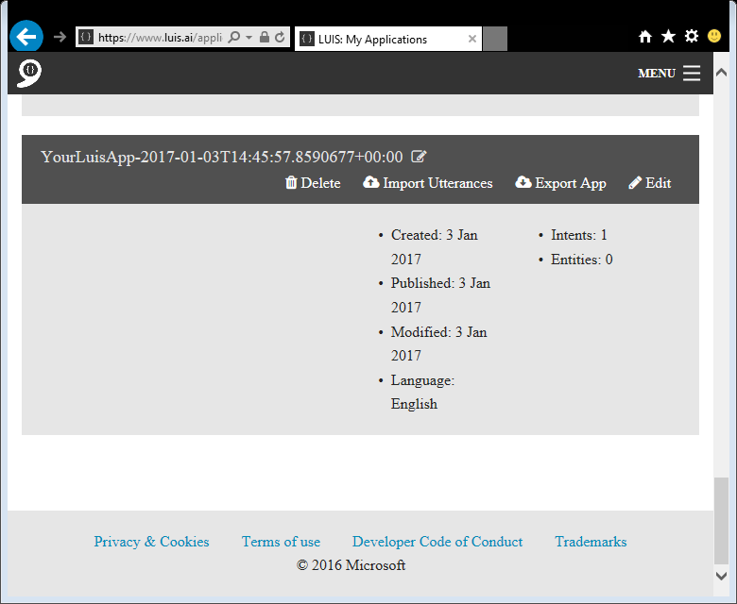
Set up Language Understanding (1/3)
Navigate to https://luis.ai/
A LUIS application was created when the bot was generated, with a non-descriptive name. Rename your LUIS application to something like “CIS Bot”.
Click Edit.

Slide 71

Set up Language Understanding (2/3)
Only one Intent is defined: None. Use the + sign to create a new intent.
As intent name, enter complain about a model
As Example utterance, enter I think the Sable has an ugly design
Click Save
Now create yet another intent, with name get info about a model and example utterance What does the Wolverine have as color?
Note that the intent names match the attributes of the callback methods in the Bot code.

Slide 72

Set up Language Understanding (3/3)
Next to Entities, click on Add customer entity.
Enter “product”, keep entity type as Simple, and click Save.
Add a second entity called “attribute” and click Save.
Train & Test
Train Application
Publish App
Add a new key to your account
Add a new key – use values output from script…
Save
Click browser back button
Click Endpoint Key drop-down and choose the account key created earlier
Publish

Slide 73
Update Bot Service LUIS API Key
A free version of LUIS was created with the Bot Service, but the quota of the free service is limited. We need to update the LuisAPIKey setting with the key of the LUIS account you created earlier.
Go to Bot Service created earlier.
Click on SETTINGS tab
Scroll down and click on Open, next to Application settings
Scroll down and look for LuisAPIKey setting and replace the value with the LUIS API key, generated from last step or from 210-create-bot.ps1 script.
Click Save

Slide 74

Simulate interactions with your Bot (1/4)
The hackathon files include a PowerShell script that simulates a few hundred human interactions with the bot. To communicate with the bot, the script requires a Web Chat channel access key.
Click the Channels tab, then, under Web Chat, click Edit.

Slide 75

Simulate interactions with your Bot (2/4)
Click Add new site and name your site Simulator.
Click Done.

Slide 76

Simulate interactions with your Bot (3/4)
Under the first Secret key, click show and copy the key to the clipboard.

Slide 77

Simulate interactions with your Bot (4/4)
Note: Need to run either Unblock-File or Set-ExecutionPolicy to allow this remote script on run on local computer.
In PowerShell, run the script Scripts\220-run-simulator.ps1.
When prompted for the Bot Webchat secret, paste the key from the previous step.
Let the simulator run for a few minutes. Then continue to the next steps, leaving the simulator running in the background.
You might see Bad Gateway errors. It’s OK to ignore them.
Good time for a break.

Slide 78

Train Language Understanding Module (1/3)
Use Active Learning to improve LUIS model.
Return to your LUIS application (https://luis.ai)
Click Intents, choose any intents, then Suggested utterances. Utterances from the simulator will appear. (It may take a few minutes before they appear.)

Slide 79

Train Language Understanding Module (2/3)
Assign utterances to them to the correct intent and identify the correct entities within the utterances.
After you’ve labeled at least a dozen utterances, click Train at the bottom of the screen.
Then review how the now-trained model correctly classifies the remaining utterances and identifies entities in them (if not, correct them and retrain the model until you’re satisfied).

Slide 80
Train Language Understanding Module (3/3)
Click Publish, then Update published application.
Run the Simulator again (or leave it running if it’s still running in the background) to produce data to report on.

Slide 81

Create real-time dashboard (1/4)
We’re almost done with Phase 1. We now create a Power BI dashboard to display real-time sentiment from Stream Analytics.
Navigate to https://powerbi.com and log in.
Click the Settings menu on the top toolbar (cogwheel icon), then Settings
Under Preview features, make sure Early access to features is set on On.
This makes the following steps slightly easier.

Slide 82

Create real-time dashboard (2/4)
Click My Workspace, then + Create
Choose Report
Search for the “cisbot” dataset.
Click on Create

Slide 83

Create real-time dashboard (3/4)
Use the provided visualizations to generate a report looking like this screenshot
Click File → Save and save your Report under the name Bot realtime data

Slide 84

Create real-time dashboard (4/4)
Click the Pin icon on the chart, and pin the visual to a new dashboard named Bot data

Slide 85
Solution implemented at this point
LUIS
Cognitive Service
Bot
Logic App
Event Hub
Stream Analytics
Power BI
Sentiment analysis
Text Analytics Cognitive Service
Data Lake Store

Slide 86
Interlude: monitoring Azure resources
We’ve implemented the main parts of the solution by now, and the simulator is pushing messages into the bot.
Let’s look at the monitoring for the various components to find out if the messages are coming through as intended.

Slide 87

Monitor your Logic App
Navigate to your Logic App.
In the Summary pane, you should see a list of successful executions.

Slide 88

Monitor your Event Hub
Navigate to your Event Hubs namespace.
In the Overview pane, in the Metrics section, you should see that incoming messages are getting through.

Slide 89

Monitor your Stream Analytics job
Navigate to your Stream Analytics job.
In the Overview pane, in the Monitoring section, you should see messages going through.

Slide 90
Phase 2: set up machine learning model
Now we prepare a training set and create a machine learning model, to allow the bot to issue the offer most likely to be accepted in each conversation.

Slide 91

Prepare ML training set (1/3) 230-generate-ml-training-data.ps1
We create a U-SQL job to process archived messages into a table containing one line for each observed interaction (pair of offer made and response received).
Navigate to your Data Lake Analytics instance.
Click Data Explorer
Browse your Data Lake Store account, to ensure the bot data is being captured into subdirectories of botdata/raw/ partitioned by year, month, day and hour.

Slide 92

Prepare ML training set (2/3) 230-generate-ml-training-data.ps1
Go to your Data Lake Analytics service
In DATA LAKE ANALYTICS, select New Job
Paste the script from \Resources\PrepareMLTrainingSet\prepare-ml-training-set.usql
Replace $storageAccountName (at the top of the script) with your storage account name (i.e. Blob storage account)
Click Submit Job

Slide 93

Prepare ML training set (3/3)
After the job completes, check that the file interactions.csv was produced in the storage account.
Click on the file name to preview its content.

Slide 94

Create AML workspace (1/2)
We create a workspace for our Azure ML experiment.
Go to New → Intelligence + Analytics → Machine Learning Workspace
Enter a name (cisbot[nn]aml)
Select your Resource group and a region
Under Web service plan pricing tier, select S1 Standard
Click Create

Slide 95

Create AML workspace (2/2)
Navigate to your newly created Machine Learning Workspace
Click “Launch Machine Learning Studio”
If you have more than one AML workspaces, then you’ll need to select the REGION, then select the workspace you created.

Slide 96

Create AML experiment (1/9)
Navigate to your Azure storage account
Under SETTINGS → Access keys, copy your primary key (key1)

Slide 97

Create AML experiment (2/9)
In Machine Learning Studio, Click + NEW, Blank Experiment

Slide 98

Create AML experiment (3/9)
Under Data Input and Output, drag Import Data onto the canvas.
For Account name, enter your Storage account name
For Account key, paste your storage account key from the previous step
For Path, type interaction-data/interactions.csv
Click RUN

Slide 99

Create AML experiment (4/9)
Click on the output of the Import Data step, and then on Visualize
Note that the columns have non-descriptive names. We will rename the columns in the next step.

Slide 100

Create AML experiment (5/9)
Under Data Transformation → Manipulation, drag Edit Metadata onto the canvas and connect it to the previous step.
Click Launch column selector and select all columns
Under new column names, enter intent, product, offer, outcome
Click Run

Slide 101

Create AML experiment (6/9)
Under Data Transformation → Sample and Split, drag Split Data onto the canvas and connect it to the previous step.
Under Fraction of rows in the first…, type 0.8
Under Machine Learning → Initialize Model → Classification, drag Two-Class Decision Forest onto the canvas

Slide 102

Create AML experiment (7/9)
Under Machine Learning → Train, drag Train Model onto the canvas
Connect it to the first data split and to the Decision Forest model
Click Launch column selector
Double-click column outcome to move it to the selected pane
Click OK

Slide 103

Create AML experiment (8/9)
Under Machine Learning → Score, drag Score Model onto the canvas
Connect it to the second data split and to the trained model
Under Machine Learning → Evaluate, drag Evaluate Model onto the canvas
Connect it to the scored model
Click Run

Slide 104

Create AML experiment (9/9)
Click on the output of the Evaluate Model step, and then on Visualize
Note the accuracy of the model is 0.643. Your figure will be slightly different because of randomness in the simulator.
In the simplest interpretation, if 50% of customers would want each of the two offers, machine learning allows us to predict the correct offer for 64.3% of customers, up from 50% with a ‘coin toss’ or by making the same offer to all customers.
Close the Evaluation results dialog.

Slide 105

Deploy AML web service
We deploy a web service to allow the bot running our trained model on new interactions, and issue the offer predicted to be the most likely to be accepted.
Click Set up Web Service → Predictive Web Service
Change the connection from Web service input to go to Score Model, rather than Edit Metadata
Click RUN
Click DEPLOY WEB SERVICE
Choose Price Plan (cisbot00amlPlan) created along with the AML workspace
Click Deploy

Slide 106
Phase 3: integrate bot with machine learning
We will set up the bot to use the ML model to issue the offer predicted to be most likely to be accepted by the customer, rather than a random offer.

Slide 107

Integrate Azure ML web service with your Bot (1/4)
After AML web service has deployed, click on the Consume tab

Slide 108

Integrate Azure ML web service with your Bot (2/4)
Copy the Primary Key and Request-Response URI

Slide 109

Integrate Azure ML web service with your Bot (3/4)
Return to your Bot Service
In BasicLuisDialog.csx, fill in the values for mlWebServiceURL and mlWebServiceApiKey
Click Save

Slide 110


Integrate Azure ML web service with your Bot (4/4)
Identify the commented out call to the ML Web Service. Uncomment the line (and comment out the line above).
Save the file
Then try interacting with the bot.

Slide 111
Phase 4: cold path processing & analytics dashboard
We will use U-SQL to extract topics from messages. This transforms unstructured data to structured data that can be stored in a data warehouse for reporting and analytics.
Data transformation and loading processes are most effectively run in batch mode (‘cold path processing’), as long as the data does not need to be updated in near-real-time in the front-end.

Slide 112

Create SQL DW (1/4) 310-create-data-warehouse.ps1
We create a Data Warehouse to store structured data extracted from messages.
Go to New → Databases → SQL Data Warehouse
Enter a name (cisbot[00]dw)
Select your resource group
Under Server, select Create a new server
Enter a unique name (cisbot[00]sql)
Select a login and password
Avoid using equals “=“ or semicolon “;” in password
Make sure you remember login and password
Select your location
Click Select

Slide 113

Create SQL DW(2/4) 310-create-data-warehouse.ps1
Under Performance, select 100
Click Create

Slide 114


Create SQL DW (3/4) 310-create-data-warehouse.ps1
In Visual Studio, Open the SQL Server Object Explorer view
Right click SQL Server → Add SQL Server
In the dialog, connect to your Azure subscription if necessary
Select your newly created SQL DW
Enter your password
Click Connect
If a dialog “Create a firewall rule” appears, click OK

Slide 115

Create SQL DW (4/4) 310-create-data-warehouse.ps1
Right-click your SQL Server instance in the SQL Server Object Explorer View
Click New Query…
Select your SQL DW database in the drop-down menu
Paste the following DDL query in the editor
Press Execute
CREATE TABLE [dbo].[BotDetailedData] (
[timestamp] datetime2(7),
[intent] nvarchar(100),
[channelId] nvarchar(100),
[id] nvarchar(100) NOT NULL,
[product] nvarchar(250),
[score] decimal(19, 10),
[text] nvarchar(4000),
[EventProcessedUtcTime] datetime2(7),
[PartitionId] bigint,
[EventEnqueuedUtcTime] datetime2(7),
[KeyPhrase] nvarchar(4000)
)
WITH (CLUSTERED COLUMNSTORE INDEX, DISTRIBUTION = HASH([id]));

Slide 116

Create Data Factory (1/7) 320-create-data-factory.ps1
We create a Data Factory pipeline to orchestrate data movement and transformation (using U-SQL jobs).
Go to New, search for “Data Factory”, click Data Factory, Create
Enter a name (cisbot[nn]adf)
Select your resource group
Select a location. Note that the region does not need to match the region where your data is located.
Click Create.

Slide 117

Create Data Factory (2/7)
In Visual Studio
Go to File → New → Project
Select Data Factory → Empty Data Factory Project
Select a name and location for your solution files
Click OK

Slide 118


Create Data Factory (3/7)
In the Solution Explorer view, right-click on your project, then Add → Existing Item…
Add all files from the Resources\ProcessBotTextDataFactory\Pipelines directory

Slide 119

Create Data Factory (4/7)
In the Solution Explorer view, right-click on your project, then Add → New Item…
Perform this operation 4 times to create the resources as specified in the table below. Make sure you name the resources exactly as indicated.
Configure passwords / account keys as guided.
Type | Name
Azure Data Lake Analytics Linked Service | DataLakeAnalyticsLinkedService
Azure Data Lake Store Linked Service | DataLakeStoreLinkedService
Azure SQL Data Warehouse Linked Service | SqlDwLinkedService
Azure Storage Linked Service | BlobLinkedService

Slide 120


Create Data Factory (5/7)
From the Solution Explorer view, open the file ProcessBotTextPipeline.json
Change the placeholder $startDate in the file with today’s date in ISO 8601 format, e.g. 2017-01-20 This will allow the pipeline to run immediately over the data collected yesterday. (If you enter today’s date, the pipeline will only run the next night at midnight).
Save the file.

Slide 121
Create Data Factory (6/7)
Note that the scheduler is set to start activities at the StartOfInterval. That means the Data Factory will process the data for a given day at the beginning of the day. This is for the purpose of this workshop, so that the slice for today starts immediately.
If you want the pipeline to process daily data in the future, change style to EndOfInterval in the Pipeline and all Dataset definitions, and publish the pipeline again.

Slide 122

Create Data Factory (7/7)
In the Solution Explorer view, right-click on your project, then Publish…
Select Create New Data Factory
Enter a name
Select your resource group and a region. Note that the region does not need to match the region where your data is located.
Click Next multiple times until the wizard completes, then Finish.

Slide 123

Monitor Data Factory (1/2)
Go to your newly created Data Factory
Click Monitor and Manage

Slide 124

Monitor Data Factory (2/2)
Check the ACTIVITY WINDOWS for the two activities in the pipeline
It may take a few minutes for the activities to light up
Check that the activities have executed successfully

Slide 125

Create historical report (1/5)
We create a report presenting data from the SQL Data Warehouse.
Navigate to your SQL Data Warehouse
Click Open In PowerBI

Slide 126

Create historical report (2/5)
Click Next, then enter your database password and click Sign In.

Slide 127

Create historical report (3/5)
Click My Workspace, then Datasets
A new dataset named after your SQL DW is listed (it might take a few minutes to appear).
Click on the “Create report” icon next to it.

Slide 128



Create historical report (4/5)
Use the Funnel visualization to create a visual like the one shown.

Slide 129




Create historical report (5/5)
Create a few more visuals such as the one shown.
Hint: use filters to exclude irrelevant content.
Click File → Save and save your Report under the name “Bot historical data”
Click the Pin icon on one of the charts, and pin the visual to the Existing dashboard named “Bot data”

Slide 130

View dashboard combining reports
As we have pinned items from both the real-time and historical reports to the same dashboard, we can use the dashboard to view those data together and jump to the detailed reports.
Click My Workspace, then click on the “Bot data” dashboard
Interact with your dashboard

Slide 131




Set up alerting (1/4)
We set up a near-real-time alert in case sentiment decreases below a certain threshold.
Run the simulator again to make sure there is data for the last 10 minutes
In the box “Ask a question about your data”, type the text average of score over last 10 minutes as gauge
The max value of the gauge will by default be the current value *2. Use the visualization controls to set the range to 0 – 1
Change the Title of the visual to Sentiment score over last 10 minutes
Click Pin visual, add the visual to the Existing dashboard named “Bot data”

Slide 132


Set up alerting (2/4)
Do you remember from the case story that Mark wanted to be alerted in near-real-time when the sentiment dropped below a certain threshold?
We will use the Data alerts functionality. It is only available on the iPhone and Windows 10 mobile apps, and the Power BI Service. We will show the iPhone app in this guide.
Install the Power BI app on your device and interact with your dashboard

Slide 133

Set up alerting (3/4)
Click on the visual “Sentiment score over last 10 minutes”. Then click on the Alerts icon (bell).

Slide 134

Set up alerting (4/4)
Set up an alert with the value is below a threshold. Set a high threshold value (e.g. 0.9) so that we can test that the alert is triggered.
It may take about an hour for the alert to be emitted.

Slide 135
Congratulations!
You’ve completed a very complex and demanding lab!

Slide 136
Machine learning everywhere!
Do you realize we’ve used machine learning in three places in this lab?

Slide 137
Machine learning everywhere!
That’s right:
LUIS uses Artificial Intelligence to match utterances by similarity to the ones that we manually labeled
We built our own scoring machine learning model in Azure ML
We used the Power BI natural language Q&A feature

Slide 138
Clean-up
Let’s delete the resources from our Azure subscription

Slide 139

Pause SQL Data Warehouse
You may want to leave the lab running for some time to share it with your friends and colleagues. If you do, make sure you Pause the SQL Data Warehouse as it will otherwise consume significant credit. Other components only incur a small cost.
Go to your SQL DW and click Pause.

Slide 140

Delete Resource Group
When you’re done, go to the Resource groups pane and click “…” next to your resource group. Then click Delete, and follow the steps in the confirmation dialog.
WARNING: this will delete all the work you’ve performed in this lab!

Slide 141

© 2017 Microsoft Corporation. All rights reserved. Microsoft, Windows, Windows Vista and other product names are or may be registered trademarks and/or trademarks in the U.S. and/or other countries.
The information herein is for informational purposes only and represents the current view of Microsoft Corporation as of the date of this presentation. Because Microsoft must respond to changing market conditions, it should not be interpreted to be a commitment on the part of Microsoft, and Microsoft cannot guarantee the accuracy of any information provided after the date of this presentation. MICROSOFT MAKES NO WARRANTIES, EXPRESS, IMPLIED OR STATUTORY, AS TO THE INFORMATION IN THIS PRESENTATION.

